Slide 1
Session 05 – Development
MIS 6311-501 Cyber Security Fundamentals
Chris Davis

Slide 2
Housekeeping
Any Questions? Please do not hesitate to email. Or text.
Class Website: https://elearning.utdallas.edu
Dropbox: https://goo.gl/9AFyoE
UTD Email: cmd140430@utdallas.edu
Gmail: davischr2@gmail.com
Google Voice: 214-771-8122 (Text & Emergencies)
LinkedIn: www.LinkedIn.com/in/ChristopherDavis
Blog: www.cloudauditcontrols.com
Class: Monday 7:00pm-9:45pm JSOM 12.210

Slide 3
Academic Calendar & Sessions

Slide 4
Tales from the Crypt.
Practical Applications & Lessons Learned.

Slide 5
https://www.microsoft.com/en-us/sdl/adopt/eop.aspx

Slide 6
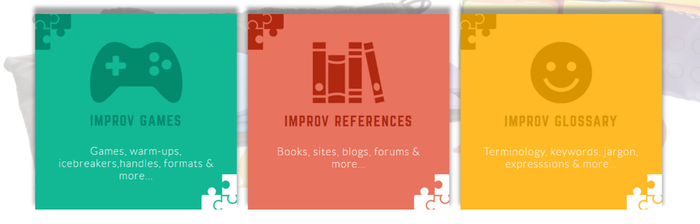
Improv Encyclopedia
http://improvencyclopedia.org/

Slide 7


Slide 8
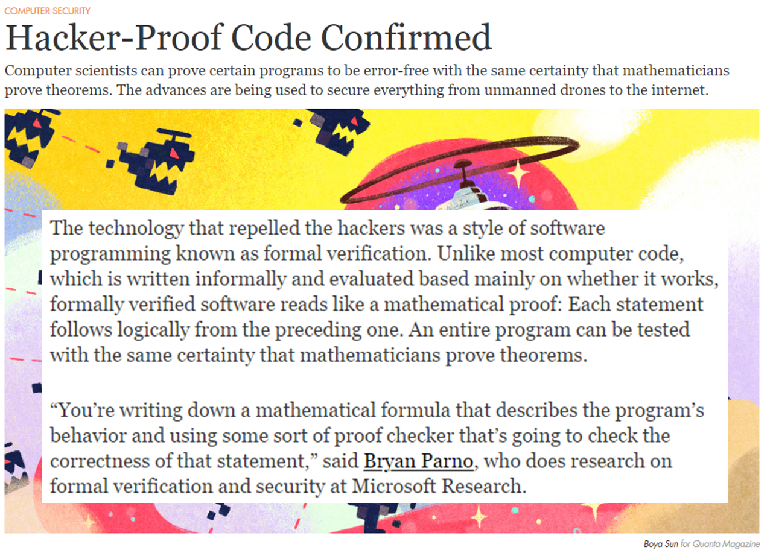
Notes:
https://www.quantamagazine.org/20160920-formal-verification-creates-hacker-proof-code/

Slide 9
CIA – SP 800-160 Definitions Systems Security Engineering
Confidentiality. Rules that govern access to, use of (i.e., operations that can be performed on), and disclosure of resources. While confidentiality policy typically applies to information and data, it may also apply to protect the knowledge of and the use of capabilities operating on the data (e.g., functions, mechanisms, services, and infrastructures);
Integrity. Rules that govern the authorized manners in which data, information, and other resources (e.g., mechanisms, functions, processes, services, and infrastructures) can be manipulated; and
Availability. Rules that govern the ability to access and use data, information, or a resource.

Slide 10


Interesting…
https://buildsecurityin.us-cert.gov/swa
http://www.cert.org/cybersecurity-engineering/index.cfm
SQUARE: http://www.cert.org/curricula/square-materials-download.cfm
Secure Coding: http://www.cert.org/secure-coding/tools/index.cfm
OLI Course: http://oli.cmu.edu/courses/future-2/secure-coding-course-details
Notes:
Security Quality Requirements Engineering (SQUARE) is a nine-step process that helps organizations build security, including privacy, into the early stages of the production lifecycle.
Secure Coding
Overview:
An ongoing development effort in collaboration with the Software Engineering Institute’s CERT, this course focuses on common security issues in C and C++ development. With security expert Robert Seacord serving as lead content author, the course addresses a key need in professional education for software developers. Topics to be covered include the secure and insecure use of integers, arrays, strings, dynamic memory, formatted input/output functions, and file I/O. Continued development is being funded by partnerships with industry.
SQUARE's Nine Steps
SQUARE’S security requirements elicitation and analysis process consists of the following nine steps:
Step 1: Agree on Definitions
Input: Candidate definitions from IEEE and other standards
Techniques: Structured interviews, focus group
Participants: Stakeholders, requirements engineer
Output: Agreed-to definitions
Step 2: Identify Assets and Security Goals
Input: Definitions, candidate goals, business drivers, policies and procedures, examples
Techniques: Facilitated work session, surveys, interviews
Participants: Stakeholders, requirements engineer
Output: Assets and goals
Step 3: Develop Artifacts to Support Security Requirements Definition
Input: Potential artifacts (e.g., scenarios, misuse cases, templates, forms)
Techniques: Work session
Participants: Requirements engineer
Output: Needed artifacts: scenarios, misuse cases, models, templates, forms
Step 4: Perform Risk Assessment
Input: Misuse cases, scenarios, security goals
Techniques: Risk assessment method, analysis of anticipated risk against organizational risk tolerance, including threat analysis
Participants: Requirements engineer, risk expert, stakeholders
Output: Risk assessment results
Step 5: Select Elicitation Techniques
Input: Goals, definitions, candidate techniques, expertise of stakeholders, organizational style, culture, level of security needed, cost benefit analysis, etc.
Techniques: Work session
Participants: Requirements engineer
Output: Selected elicitation techniques
Step 6: Elicit Security Requirements
Input: Artifacts, risk assessment results, selected techniques
Techniques: Joint Application Development (JAD), interviews, surveys, model-based analysis, checklists, lists of reusable requirements types, document reviews
Participants: Stakeholders facilitated by requirements engineer
Output: Initial cut at security requirements
Step 7: Categorize Requirements as to Level (System, Software, etc.) and Whether They Are Requirements or Other Kinds of Constraints
Input: Initial requirements, architecture
Techniques: Work session using a standard set of categories
Participants: Requirements engineer, other specialists as needed
Output: Categorized requirements
Step 8: Prioritize Requirements
Input: Categorized requirements and risk assessment results
Techniques: Prioritization methods such as Triage, Win-Win
Participants: Stakeholders facilitated by requirements engineer
Output: Prioritized requirements
Step 9: Inspect Requirements
Input: Prioritized requirements, candidate formal inspection technique
Techniques: Inspection methods such as Fagan, peer reviews
Participants: Inspection team
Output: Initial selected requirements, documentation of decision-making process and rationale

Slide 11

BA-A-A-A-DD USB!!!
Caudill says that by publishing their code, he and Wilson are hoping to start that security process. But even they hesitate to release every possible attack against USB devices. They’re working on another exploit that would invisibly inject malware into files as they are copied from a USB device to a computer. By hiding another USB-infecting function in that malware, Caudill says it would be possible to quickly spread the malicious code from any USB stick that’s connected to a PC and back to any new USB plugged into the infected computer. That two-way infection trick could potentially enable a USB-carried malware epidemic. Caudill considers that attack so dangerous that even he and Wilson are still debating whether to release it.
“There’s a tough balance between proving that it’s possible and making it easy for people to actually do it,” he says. “There’s an ethical dilemma there. We want to make sure we’re on the right side of it.”
http://www.wired.com/2014/10/code-published-for-unfixable-usb-attack/
https://github.com/adamcaudill/Psychson
Notes:
ACT I
http://arstechnica.com/security/2014/07/this-thumbdrive-hacks-computers-badusb-exploit-makes-devices-turn-evil/
Now, white-hat hackers have devised a feat even more seminal—an exploit that transforms keyboards, Web cams, and other types of USB-connected devices into highly programmable attack platforms that can't be detected by today's defenses.
Dubbed BadUSB, the hack reprograms embedded firmware to give USB devices new, covert capabilities. In a demonstration scheduled at next week's Black Hat security conference in Las Vegas, a USB drive, for instance, will take on the ability to act as a keyboard that surreptitiously types malicious commands into attached computers. A different drive will similarly be reprogrammed to act as a network card that causes connected computers to connect to malicious sites impersonating Google, Facebook or other trusted destinations. The presenters will demonstrate similar hacks that work against Android phones when attached to targeted computers. They say their technique will work on Web cams, keyboards, and most other types of USB-enabled devices.
ACT II
http://www.wired.com/2014/10/code-published-for-unfixable-usb-attack/
By hiding another USB-infecting function in that malware, Caudill says it would be possible to quickly spread the malicious code from any USB stick that’s connected to a PC and back to any new USB plugged into the infected computer. That two-way infection trick could potentially enable a USB-carried malware epidemic. Caudill considers that attack so dangerous that even he and Wilson are still debating whether to release it.
“There’s a tough balance between proving that it’s possible and making it easy for people to actually do it,” he says. “There’s an ethical dilemma there. We want to make sure we’re on the right side of it.”

Slide 12
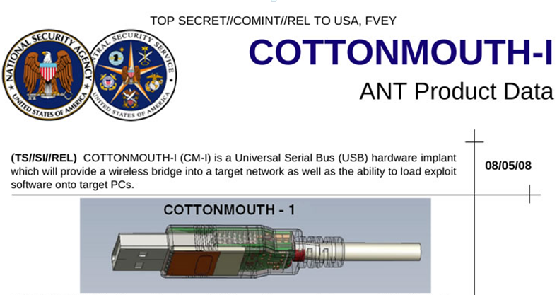
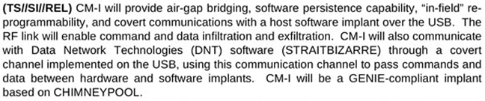

Slide 13
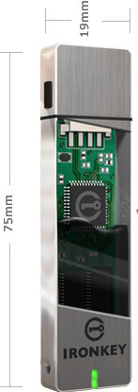
IRONKEY
Boing Boing's Cory Doctorow has a slightly more apocryphal bit of advice — apparently, someone with high-level connections to the U.S. intelligence community told Doctorow "the spooks he worked with would only trust USB thumb-drives from one vendor, a U.S.-based firm that had been vetted by American spies.“
Additional key security features available: Secure, military-grade 256-bit AES full disk hardware encryption; FIPS 140-2 Level 3; remote wipe/disable of lost or stolen devices; Multifactor authentication; Ruggedized, waterproof; tamper evident;
Virus/malware protection
http://boingboing.net/2014/10/03/sourcecode-for-unpatchable.html

Slide 14


Slide 15
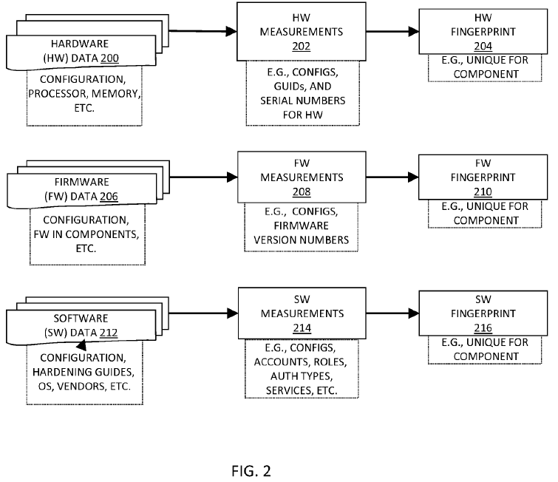
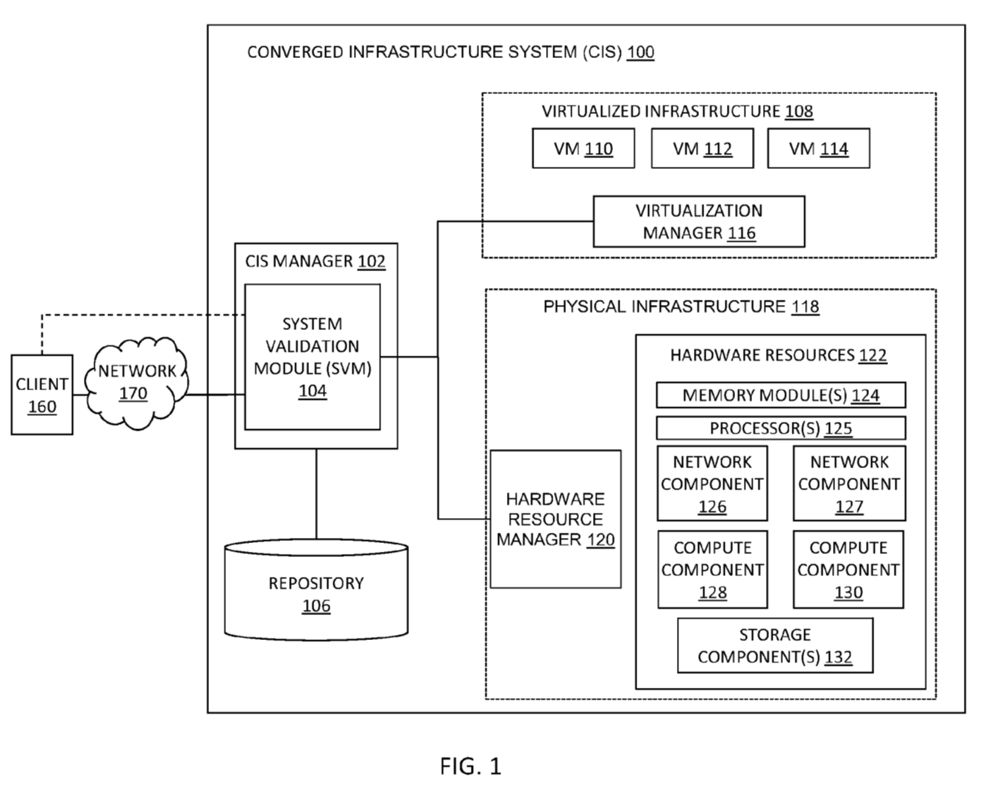
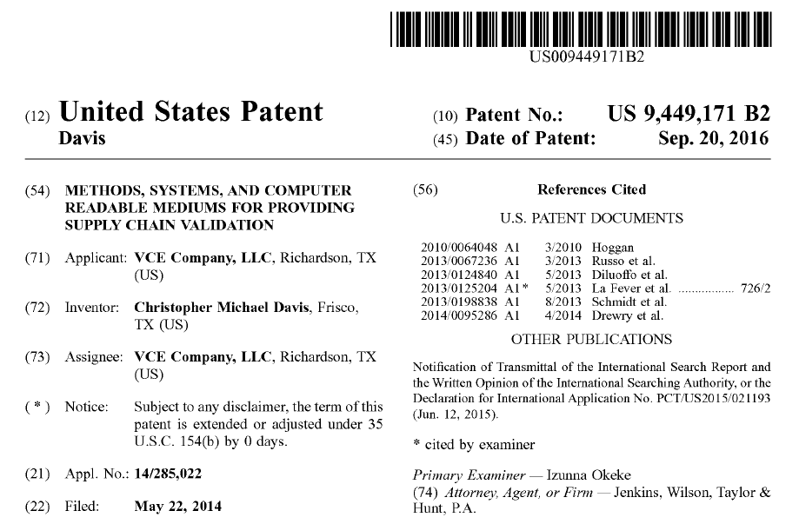

Slide 16
DEMYSTIFYING THE INTERNET OF THINGS
ITL BULLETIN FOR SEPTEMBER 2016
NIST Special Publication 800-183
Networks of ‘Things’
NIST SP 800-183 presents five primitives and six elements that impact IoT trustworthiness.
Primitives are the building blocks and also allow for analytics and formal arguments of IoT use case scenarios
Elements are the less tangible trust factors impacting NoTs.
The model and vocabulary presented expresses how IoT, in the broad sense, behaves.
GREAT PROJECT MATERIAL
http://csrc.nist.gov/publications/nistbul/itlbul2016_09.pdf
http://nvlpubs.nist.gov/nistpubs/SpecialPublications/NIST.SP.800-183.pdf

Slide 17
INTERNET OF THINGS: Primitives for Build
Sensor - an electronic utility that measures physical properties such as temperature, acceleration, weight, sound, location, presence, identity, etc. All sensors employ mechanical, electrical chemical, optical, or other effects at an interface to a controlled process or open environment.
Aggregator - a software implementation based on mathematical function(s) that transforms groups of raw data into intermediate, aggregated data. Raw data can come from any source. Aggregators help in managing ‘big’ data.
Communication channel - a medium by which data is transmitted (e.g., physical via Universal Serial Bus [USB], wireless, wired, verbal, etc.).
eUtility (external utility) - a software or hardware product or service, the current definition of which is deliberately broad to allow for unforeseen future services and products that will be incorporated in types of NoT yet to be defined.
Decision trigger – a mechanism that creates the final result(s) needed to satisfy the purpose, specification, and requirements of a specific NoT.

Slide 18
INTERNET OF THINGS: Elements of Trust (1/2)
Environment - the universe in which all the primitives of a specific NoT operate. The environment is essentially the operational profile of a NoT and is particularly important to the sensor and aggregator primitives since it offers them context. An analogy is the various weather profiles that an aircraft operates in, or a particular factory setting that a NoT operates in.
Cost - the expenses, in terms of time and money, that a specific NoT incurs in terms of the nonmitigated reliability and security risks; additionally, the costs that are associated with each of the primitive components needed to build and operate a NoT. Cost is an estimation or prediction that can be approximated or measured, and helps drive design decisions in building a NoT.
Owner - a person or organization that owns a particular sensor, aggregator, communication channel, eUtility, or decision trigger. There can be multiple owners for any of these five. Note that there is also a role for an operator; for simplicity, we roll up that role into the owner element.

Slide 19
INTERNET OF THINGS: Elements of Trust (2/2)
Geographic location - a physical place where a sensor or eUtility operates. For example, a system might use radio-frequency identification (RFID) technology to determine the physical location in which a ‘thing’ actually resides. Note that the operating location may change over time. A sensor’s or eUtility’s geographic location, along with communication channel reliability and data security, may affect timing aspects of dataflow throughout a NoT’s workflow. Specific geographic location may sometimes be difficult or impossible to determine.
Device_ID - a unique identifier for a particular sensor, aggregator, communication channel, eUtility, or decision trigger, typically originating from the manufacturer. While the identifier is important, those relying upon the Device_ID for authentication should be aware that the identifier could be modified or forged.
Snapshot - an instant in time, utilized for synchronization of events fired by any of the five primitives.

Slide 20
Let’s Get Started.

Slide 21
Session Contents
This chapter presents the following:
Common software development issues • Software development life cycles • Secure software development approaches • Change control and configuration management • Programming language types • Database concepts and security issues • Expert systems and artificial intelligence • Malware types and attacks
Notes:
Security terminology and principles • Protection control types • Security frameworks, models, standards, and best practices • Security enterprise architecture • Risk management • Security documentation • Information classification and protection • Security awareness training • Security governance
Harris, Shon (2012-11-08). CISSP All-in-One Exam Guide, 6th Edition (Kindle Locations 1007-1011). McGraw-Hill Education. Kindle Edition.

Slide 22
Chris's View

Slide 23

Today's Materials
Harris, Shon (2012-11-08).
CISSP All-in-One Exam Guide, 6th Edition.
McGraw-Hill Education.

Slide 24
Chapter 10: Software Development Security

Slide 25
Overview
Applications are the primary purpose of any computer/network system.
Applications are usually developed for functionality first, security is often an afterthought.

Slide 26
Overview
Proper application security requires that security is a primary concern in the development process. Security should be:
interwoven into the core of a product and
provide protection at different layers.
Security should NOT be tried to applied on later.

Slide 27
Why is security usually overlooked during development?
Often people try to secures the perimeter and leave internal applications wide open.
This happens because:
In the past, security was often not a concern as systems were less connected
Software developers are not usually security people
Vendors want to rush out a product to market, security slows things down

Slide 28
How application and security usually goes…
Product is pushed out the door by vendors
Crackers find vulnerabilities
Sites post the vulnerabilities (bugtraq, NT-bugtraq etc)
Vendor develops and releases patch to fix vulnerability
Admins test and apply patches
This is very reactive, the model needs to change to be proactive.

Slide 29
Problems with Application Security
Developers/vendors want easy to use, easy to setup, highly functional software
Functionality/usability and security are inversely related
Even when security controls exist, they are usually disabled or set by default to easy/functional settings rather than highly security settings.

Slide 30
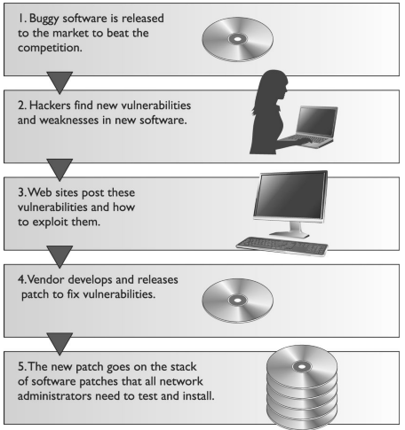
Where do we place security?
This chapter is an attempt to show how to address security at its source, which is at the software development level.
This requires a shift from reactive to proactive actions toward security problems to ensure they do not happen in the first place, or at least happen to a smaller extent.

Slide 31
System Development Lifecycle

Slide 32
System Development Life Cycle
Very simply… a life cycle is a representation of development changes.
Projects have a life cycle: initiation, planning, execution and controlling, and closure.
A system has its own developmental life cycle:
Initiation -- Need for a new system is defined
Acquisition/ development -- New system is either created or purchased
Implementation -- New system is installed into production environment
Operation/ maintenance -- System is used and cared for
Disposal -- System is removed from production environment
Notes:
System Development Life Cycle A life cycle is a representation of development changes. A person is conceived, born, matures (baby, toddler, teenager, middle age, elderly), and dies. Such is the circle of life. Projects have a life cycle: initiation, planning, execution and controlling, and closure. A system has its own developmental life cycle, which is made up of the following phases: initiation, acquisition /development, implementation, operation/ maintenance , and disposal. Collectively these are referred to as a system development life cycle (SDLC). Here are the basic components of each phase: • Initiation Need for a new system is defined • Acquisition/ development New system is either created or purchased • Implementation New system is installed into production environment • Operation/ maintenance System is used and cared for • Disposal System is removed from production environment

Slide 33
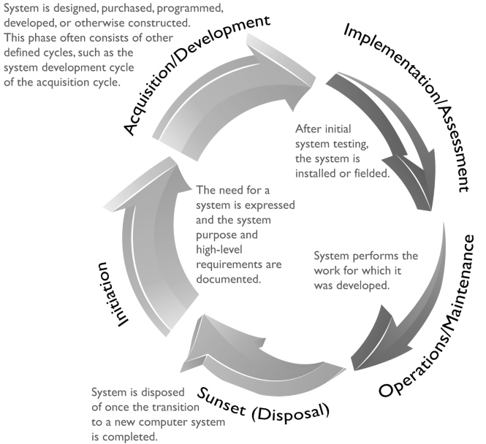
System DLC High Level Steps

Slide 34
System DLC Models & Methodologies
There are different SDLC models and methodologies, but each follows the same or similar phases laid out earlier.
It is important that security be integrated at each phase, no matter what SDLC model is used.
Sensitive data must be protected as they are transmitted, processed, and stored, and individual systems must be protected from a long list of potential threats.
A risk management process should be employed to balance:
the requirements of protecting the organization and its assets, and
the costs of security countermeasures necessary to mitigate identified risks.

Slide 35
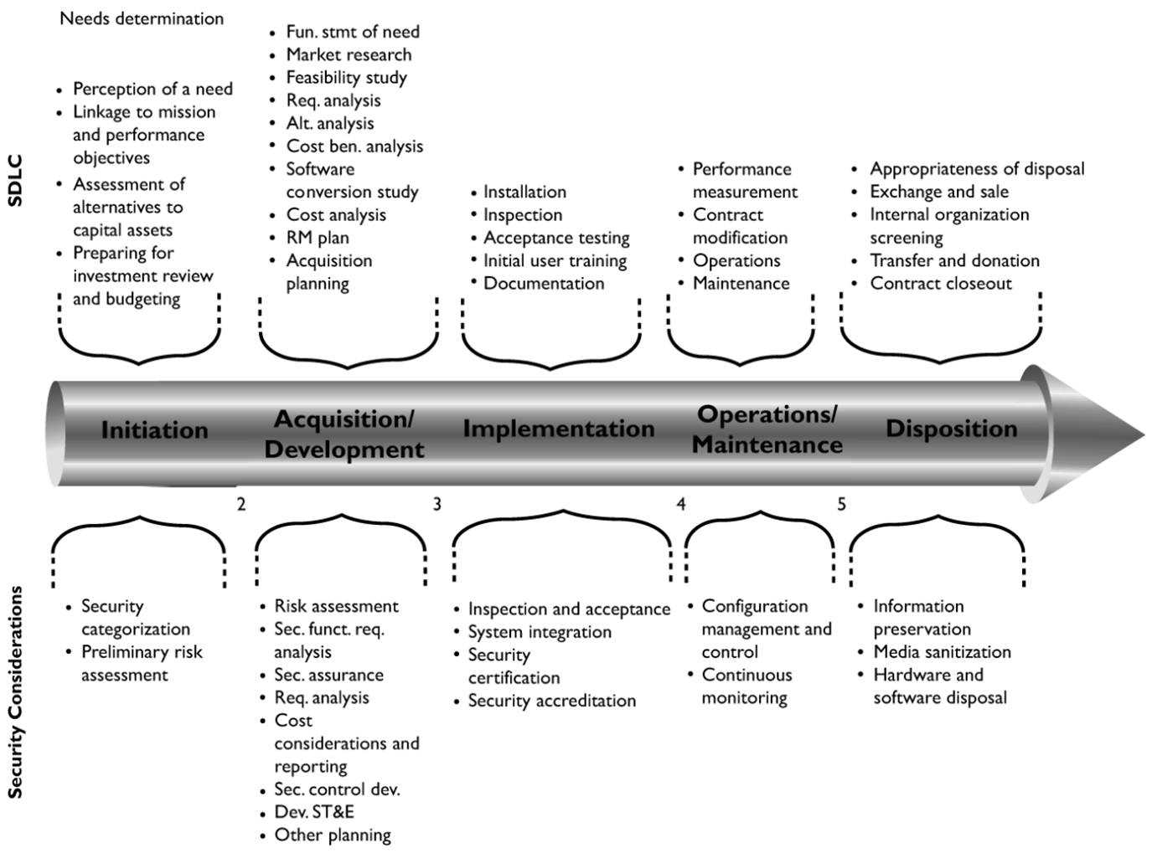

Slide 36
Software Development Lifecycle

Slide 37
Software Development Lifecycle
There have been several software development life cycle (SDLC) models developed over the years, which we will cover later in this section, but the crux of each model deals with the following items:
Requirements gathering -- Determine the why create this software, the what the software will do, and the for whom the software will be created
Design -- Deals with how the software will accomplish the goals identified, which are encapsulated into a functional design
Development -- Programming software code to meet specifications laid out in the design phase
Testing/ Validation -- Validating software to ensure that goals are met and the software works as planned
Release/ Maintenance -- Deploying the software and then ensuring that it is properly configured, patched, and monitored

Slide 38
Design Phase
Some companies skip the functional design phase, which can cause major delays down the road and redevelopment efforts, because a broad vision of the product needs to be understood before looking strictly at the details.
Software requirements commonly come from three models:
Informational model -- Dictates the type of information to be processed and how it will be processed
Functional model -- Outlines the tasks and functions the application needs to carry out
Behavioral model -- Explains the states the application will be in during and after specific transitions take place

Slide 39
Design Phase: Antivirus Example
For example, an antivirus software application may have an informational model that dictates what information is to be processed by the program, such as virus signatures, modified system files , checksums on critical files, and virus activity.
It would also have a functional model that dictates that the application should be able to scan a hard drive , check e-mail for known virus signatures, monitor critical system files , and update itself.
The behavioral model would indicate that when the system starts up, the antivirus software application will scan the hard drive and memory segments. The computer coming online would be the event that changes the state of the application . If a virus were found, the application would change state and deal with the virus appropriately. Each state must be accounted for to ensure that the product does not go into an insecure state and act in an unpredictable way.

Slide 40
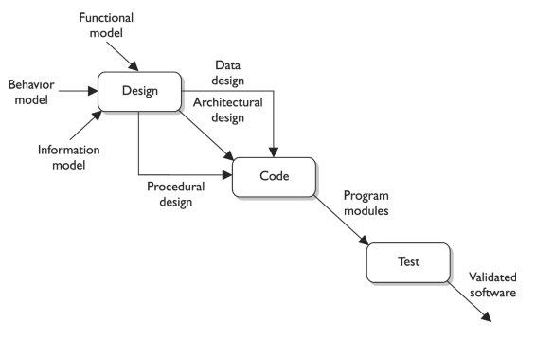
Design Phase Outputs: Data, Architecture, Procedure Designs

Slide 41
Threat Modeling
An attack surface is what is available to be used by an attacker against the product itself.
The aim of an attack surface analysis is to identify and reduce the amount of code and functionality accessible to untrusted users.
Threat modeling is a systematic approach used to understand how different threats could be realized and how a successful compromise could take place.

Slide 42
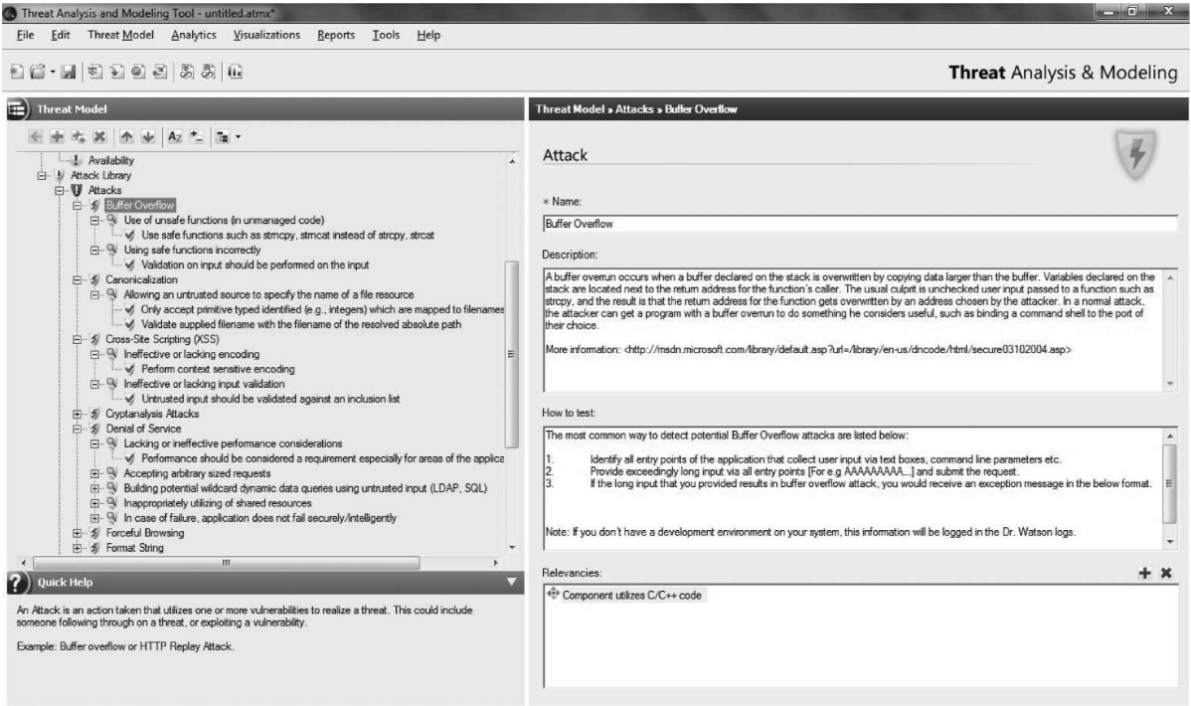
Threat Modeling Software Tools

Slide 43
2011 CWE/SANS Top 25 Most Dangerous Software Errors
Common Weakness Enumeration
List of the most widespread and critical errors that can lead to serious vulnerabilities in software.
They are often easy to find, and easy to exploit.
They are dangerous because they will frequently allow attackers to completely take over the software, steal data, or prevent the software from working at all.
http://cwe.mitre.org/top25/#Listing

Slide 44
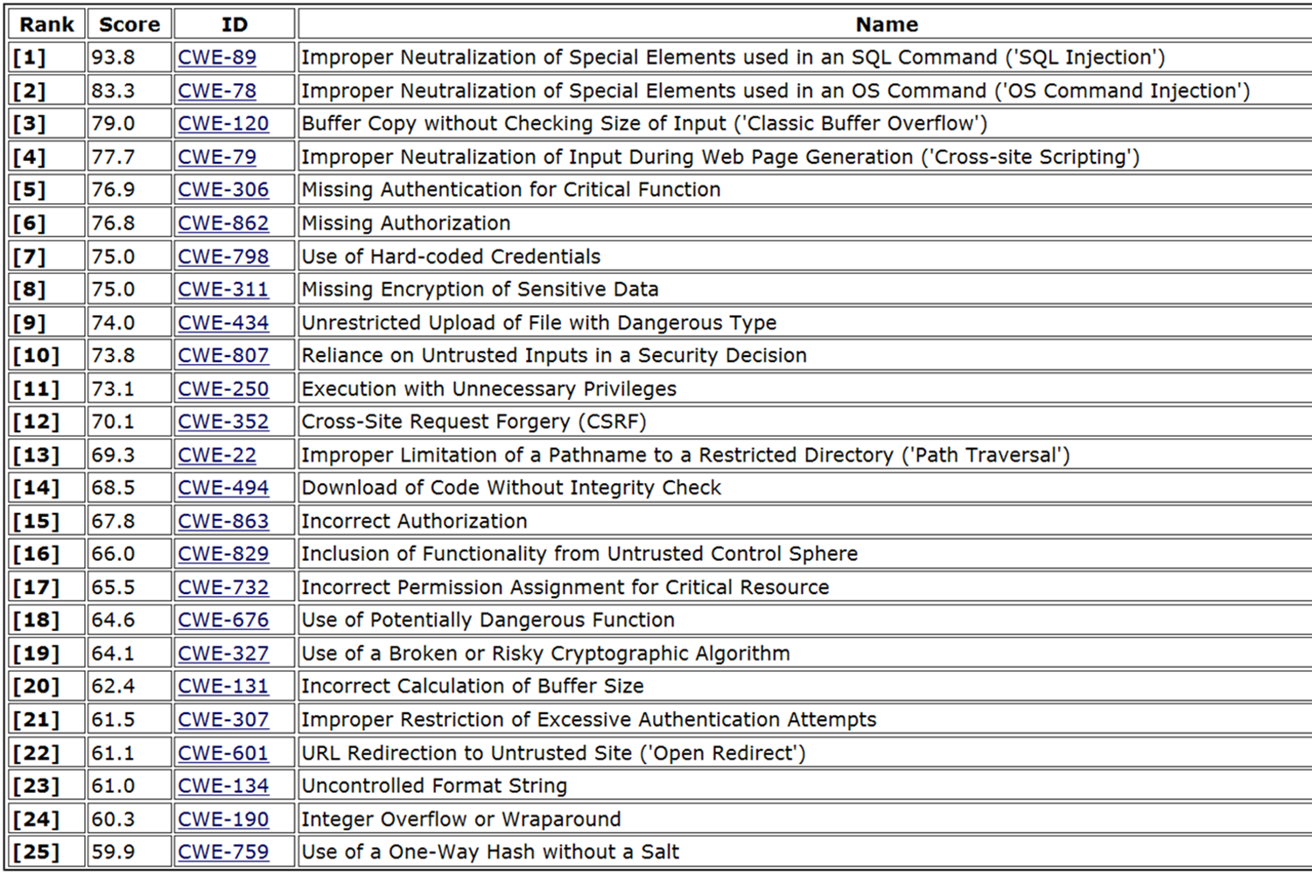

Slide 45
SDLC and Security Tasks
Requirements gathering
Security risk assessment
Privacy risk assessment
Risk-level acceptance
Informational, functional, and behavioral requirements
Design
Attack surface analysis
Threat modeling
Development
Automated CASE tools
Static analysis
Testing/ Validation
Dynamic analysis
Fuzzing
Manual testing
Unit, integration, acceptance, and regression testing
Release/ Maintenance
Final security review

Slide 46
Key Terms
Statement of Work (SOW) -- Describes the product and customer requirements. A detailed-oriented SOW will help ensure that these requirements are properly understood and assumptions are not made.
Work breakdown structure (WBS) -- A project management tool used to define and group a project’s individual work elements in an organized manner.
Privacy Impact Rating -- Indicates the sensitivity level of the data that will be processed or made accessible.
Attack surface -- Components available to be used by an attacker against the product itself.
Attack surface analysis -- Identify and reduce the amount of code accessible to untrusted users.
Threat modeling -- A systematic approach used to understand how different threats could be realized and how a successful compromise could take place.

Slide 47
Key Terms
Computer-aided software engineering (CASE) -- Refers to software that allows for the automated development of software, which can come in the form of program editors, debuggers, code analyzers, version-control mechanisms, and more.
Static analysis -- A debugging technique that is carried out by examining the code without executing the program, and therefore is carried out before the program is compiled.
Fuzzing -- A technique used to discover flaws and vulnerabilities in software.
Verification -- Determines if the product accurately represents and meets the specifications.
Validation -- Determines if the product provides the necessary solution for the intended real-world problem.

Slide 48
Secure Development Best Practices
SP 800-160

Slide 49
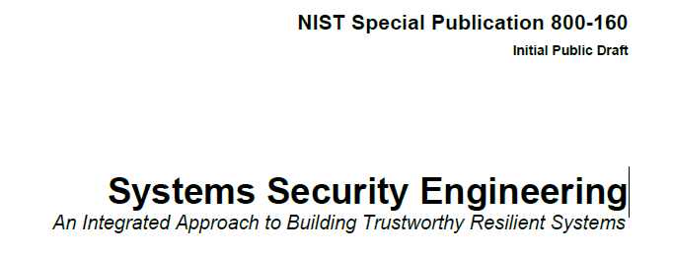
NIST Special Publication 800-160
THE PROCESSES
3.1 STAKEHOLDER REQUIREMENTS DEFINITION PROCESS
3.2 REQUIREMENTS ANALYSIS PROCESS
3.3 ARCHITECTURAL DESIGN PROCESS
3.4 IMPLEMENTATION PROCESS
3.5 INTEGRATION PROCESS
3.6 VERIFICATION PROCESS
3.7 TRANSITION PROCESS
3.8 VALIDATION PROCESS
3.9 OPERATION PROCESS
3.10 MAINTENANCE PROCESS
3.11 DISPOSAL PROCESS

Slide 50
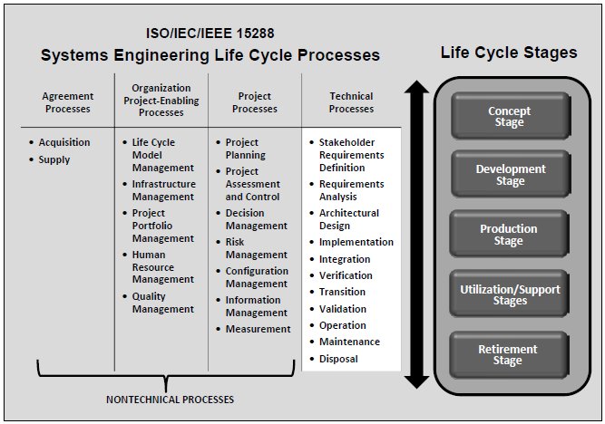

Slide 51
Key Terms
Web Application Security Consortium (WASC) -- A nonprofit organization made up of an international group of experts, industry practitioners, and organizational representatives who produce open-source and widely agreed upon best-practice security standards for the World Wide Web.
Open Web Application Security Project (OWASP) -- A nonprofit organization focused on improving the security of application software.
Build Security In (BSI) -- U.S. DHS effort that provides best practices, tools, guidelines, rules, principles, and other resources for software developers, architects, and security practitioners to use.
ISO/ IEC 27034 -- International standard that provides guidance to assist organizations in integrating security into the processes used for managing their applications. It is applicable to in-house developed applications, applications acquired from third parties, and where the development or the operation of the application is outsourced.

Slide 52
DATABASES
Databases are simply organized containers for storing data. But the devil is in the details. Ask the DBA.

Slide 53
Relational Database
Parts
Data structures: tables or relations
A relational data base stores data in relations.
A relation can be thought of as a table
Integrity rules on allowable values and value combinations
Operators on the data in the tables
Schema
Data Description Language (DDL)
Database Management System (DBMS)
Relation – table
Records or Tuples – rows
Attributes – columns
Cardinality – number rows
Degree – number columns or attributes
Domain – set of values attribute can take

Slide 54
Relational Database
Relation
Schema
Attributes
Degrees
Tuples
Domain
Cardinality
Primary Key

Slide 55
Relational Database
1 – (The following table)
3 – (Multiple Tables)
2 – (Columns)
4 – (Number Attributes)
5 –
(Set of Attribute
Values --
Mavericks,
Celtics, etc)
8 –
(Rows)
7 –
(Number Rows)
6 –
(unique values)

Slide 56
Database Applications
Two-tiered model
Three-tiered model
Common Database Vendors
Oracle
IBM
MySQL
Sybase
Microsoft SQL

Slide 57
Database Components
Program Files
Configuration Values
Data Files
Client/Network Libraries
Backup & Restore System
SQL Statements
SQL statement | Description
SELECT | View a subset of data from a table.
INSERT | Add new data to a table.
UPDATE | Modify existing data in a table.
DELETE | Remove a subset of data from a table.

Slide 58
Common Select Statement
The statement you will need to understand best is SELECT.
SELECT <COLUMN LIST> FROM <TABLE NAME> WHERE <CONDITION>
<COLUMN LIST> is a comma-separated list of column names that will be displayed
<TABLE NAME> is replaced with the name of the table to be displayed
<CONDITION> and the word WHERE are optional. If you do not indicate a WHERE clause, all rows in the table are returned. Using the WHERE clause, you can SELECT only the rows you are interested in.
Example of selecting the first and last names of all employees where the employee makes more than $20,000 is show here:
SELECT FIRST_NAME, LAST_NAME FROM EMPLOYEES WHERE SALARY > 20000

Slide 59
Database Objects and Data Dictionary
Common database objects (there are also proprietary objects)
The database stores metadata about itself. This metadata is referred to as the data dictionary, or also sometimes referred to as the system tables.
Object type | Description
Table | Stores rows of data in one or more columns.
View | A SELECT statement on top of a table or another view that creates a virtual table. Views can change the number or order of columns, call functions, and manipulate data in a variety of ways.
Stored procedure/function | Procedural code that can be called to execute complex functionality within the database. Functions return values. Procedures do not return values. Stored procedures are very efficient for data access.
Trigger | Procedural code that is called when a table is modified. Can be used to perform any actions, including modifications to other tables, when data is changed.
Index | Mechanism to provide fast lookup of data. Indices are complex objects and their proper tuning is critical to database performance.

Slide 60
Database Management
This Section: Extra Information

Slide 61
Databases
Databases are centralized systems that store, manipulate and query data.
Databases are the back ends of almost all enterprise products.
A DBMS is a suite of programs used to manage “large sets of structured data with ad hoc query capabilities for many types of users…” i.e. a database.

Slide 62
Databases
Databases should provide the following features and characteristics
Centralized data storage
Easier backup /centralized
Transaction persistence
Consistency of data
Recovery and fault tolerance
Sharing of data with multiple users
Security controls that implement integrity checking, access control and can provide confidentiality

Slide 63
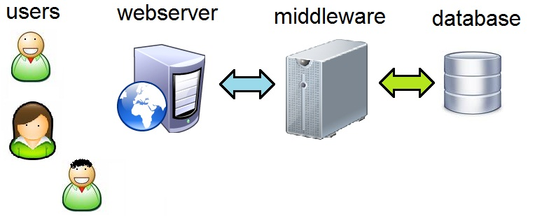
Databases
Databases used to be on the backend away from users, but now organizations write code that lets user query and manipulate their databases. This is usually done via a web front end and a middleware component.

Slide 64
Middleware
Middleware is an often misunderstood term
Allows different systems to communicate
Used by web systems to manipulate databases in a structured and secured fashion.
Is to the web server code as a view is to a user.
Allows the web servers to access the database using pre-defined methods, which are limited, have access controls and monitored
Protects the database from the code on the web servers, only valid queries/transactions are allowed via the middleware components.

Slide 65
Database Models
There are different types of database models
Relational
Hierarchical
Network
Object oriented
Object relational
We will discuss each in the next couple slides

Slide 66
Databases Relational
The traditional database model.
Uses attributes (columns) and tuples (rows) to store and organize data.
These tuples create tables (next slide)
Most commonly used type of database
(more)

Slide 67
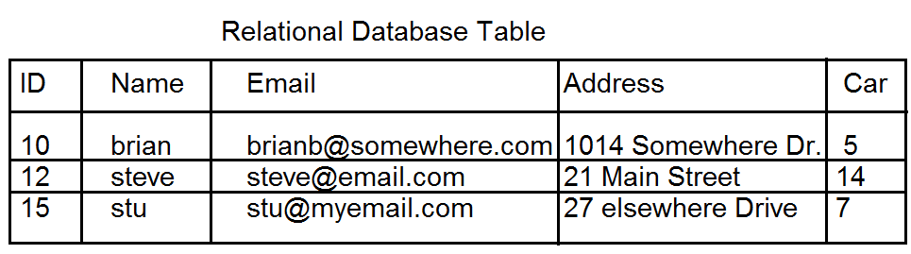
Relational Database (Table)

Slide 68
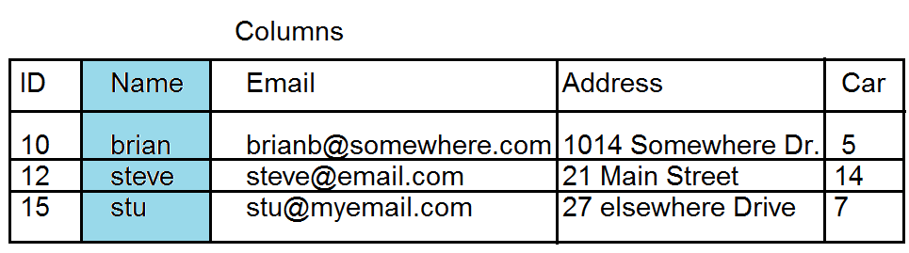
Relational Database (Attributes/Columns)

Slide 69
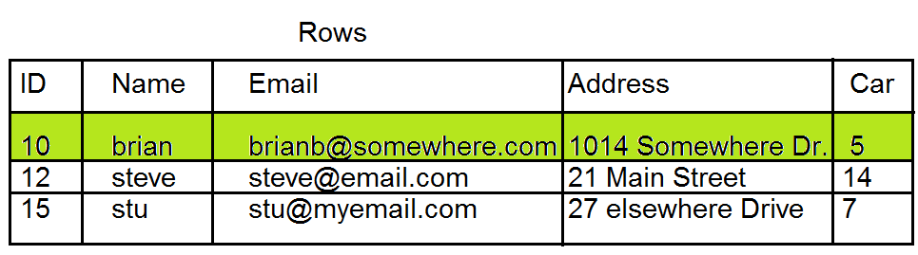
Relational Database (Records/Rows/Tuple)

Slide 70
Relational Database
Entries in a relational database are linked by relationships.
Primary key is a unique identifier for each object in a table
Foreign keys link rows (entries) in 1 database table to related rows in another table. Foreign keys in one table reference primary keys in another table
see slides

Slide 71
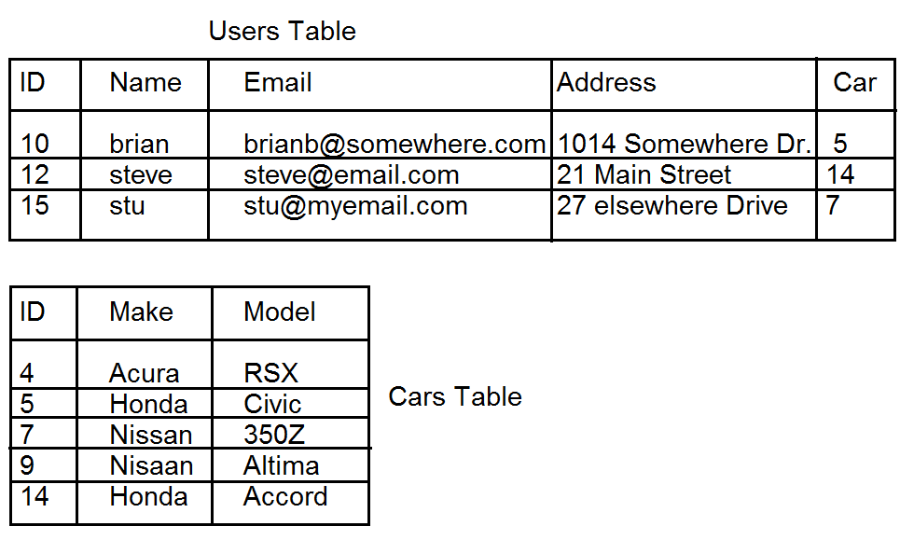
Database Tables

Slide 72
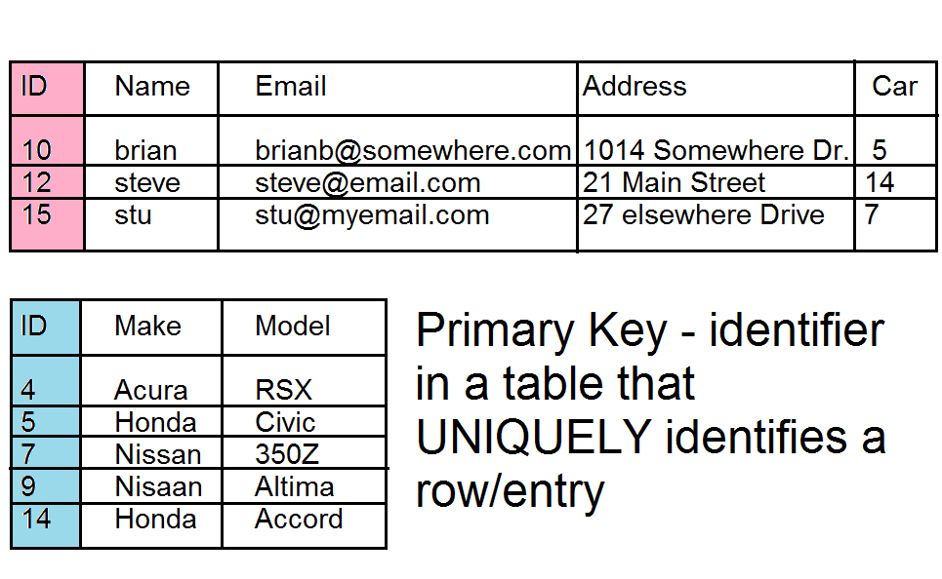
Primary Keys

Slide 73
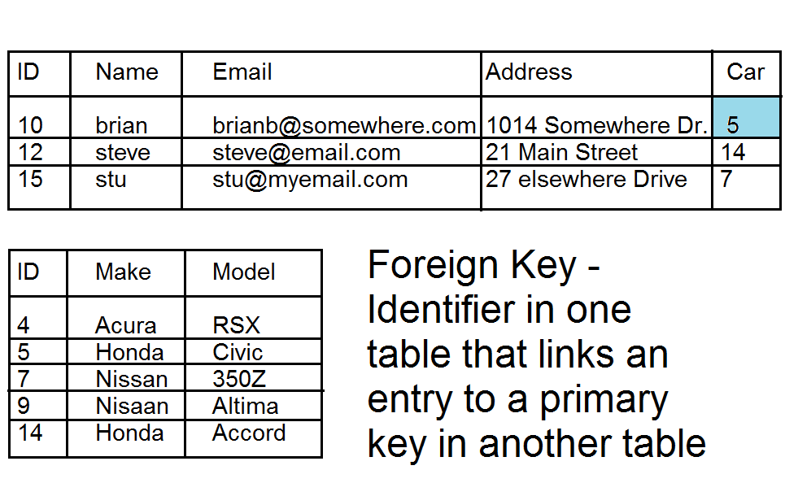
Foreign Keys

Slide 74
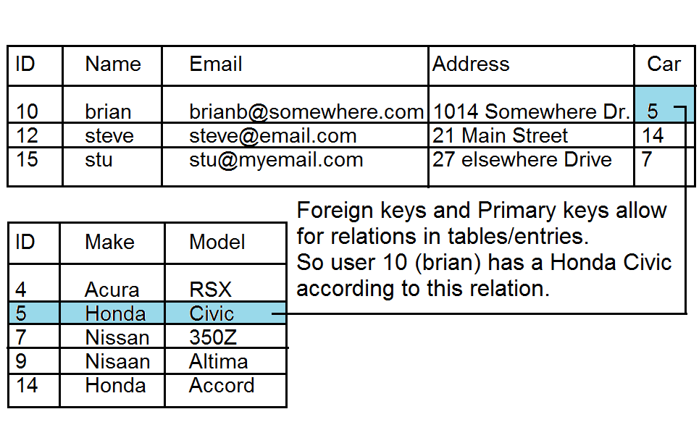
Relationship of Primary and Foreign Keys

Slide 75
Hierarchical Database
Like a tree. Relationships are defined by parent, child relationships.
Some applications that use this type of database are:
DNS
LDAP / Active Directory
Windows Registry.
see visual next slide

Slide 76
Hierarchical database
.
.com
.edu
.microsoft
.paladingrp
.umbc
.stanford
www
.research
.sales
.csee
mail
www

Slide 77
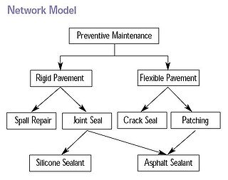
Databases, network model
Similar to hierarchical, however each node in the tree may have multiple parent nodes. This forms a network or a mesh rather than a tree structure.

Slide 78
Databases Object oriented
Rather than having rows and columns, OOB type databases work like object oriented programs and present data as objects, these objects can provide methods on accessing and manipulating data.
Not as common as relational databases, but used in niche markets (engineering, biology, financial sector)

Slide 79
Database Common Terms
Record – a collection of related data items
Tuple – a row/record in a relational database
Attribute – a column in a relational database
Primary key – the primary identifier in a relational database
Foreign Key – an attribute in one table (RD) that links to a primary key in another table to provide a relationship between two records in a database
more

Slide 80
Database Common Terms
Schema – The structure of the database (what tables exist, what data they have in them, how are tables linked together)
Data Dictionary - data about how the database is laid out, what types of data types exist and other metadata.

Slide 81
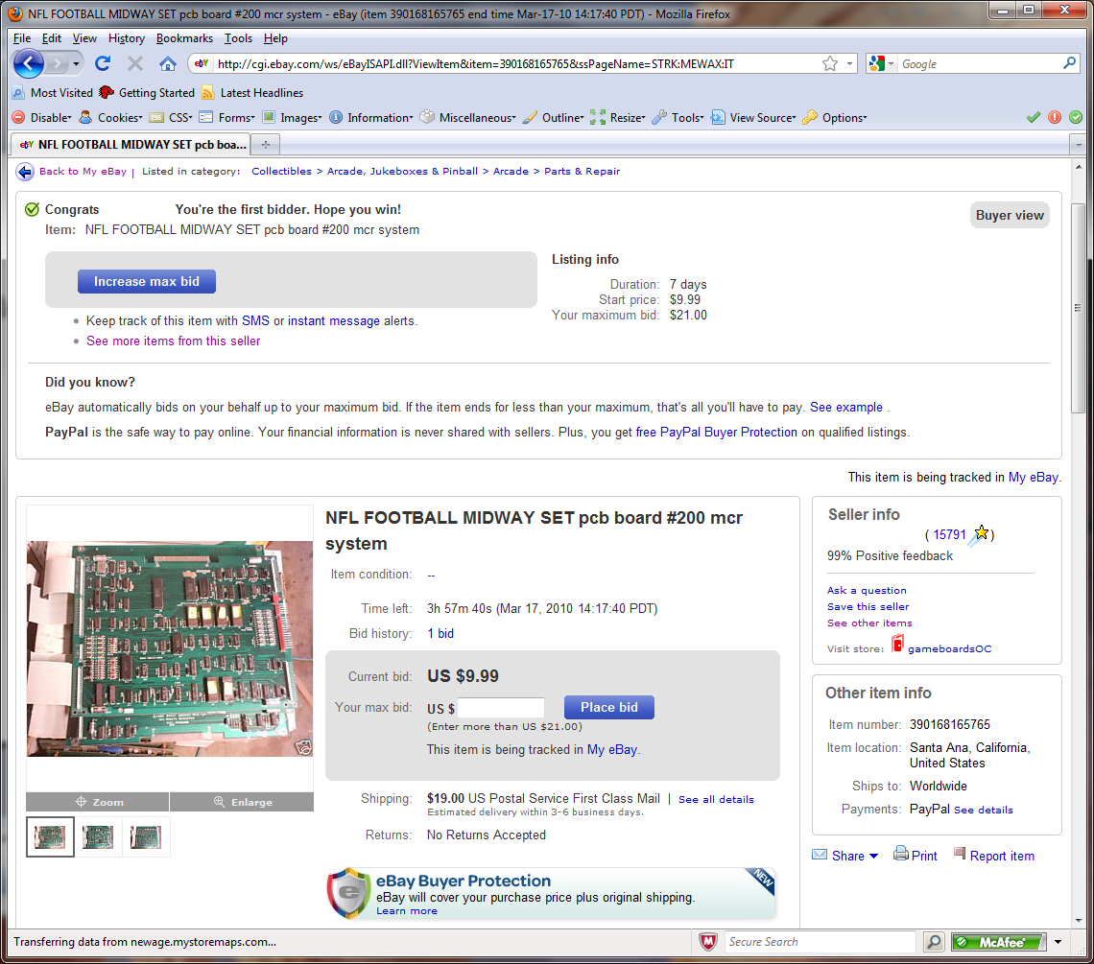
View – a window that provides a user only the data they are allowed to access

Slide 82
SQL
SQL – Structured query language - a standardized language for accessing databases, uses natural language
SQL example next page

Slide 83
SQL Example
SELECT id,email, address FROM users WHERE id=10;
Would return
10, brianb@somewhere.com, 1014 Somewhere Dr.

Slide 84
Database Integrity Concepts
Transaction – a series of database updates that are grouped together, such that all updates occur or NONE of them occur.
Example
when transferring money from accounts in a bank, a transaction MUST occur
Money is deducted from account #1
Money is added to account #2
If either of these fail the completed change should be voided, this change is called a rollback! If the transaction succeeds we finalize it with a commit which makes the change and lets the new contents be viewed by other queries.

Slide 85
Database Integrity Concepts
Referential integrity – assures that any foreign key has a matching primary key.
Referential integrity Example next slide

Slide 86
Referential Integrity Example
There MUST exist a entry in the car table with ID 5,14, and 7, since there is a foreign key in the users table that reference these values in the car table.

Slide 87
ACID
ACID
Atomicity – Database changes are atomic, all changes in a transaction take place or none do.
Consistency – all data is consistent within the database
Isolation – database transactions do not interfere with each other. The results of a running transaction is not available into another process until the transaction is complete.
Durability – Once the transaction is committed it is permanent.

Slide 88
Database Security Concerns
Aggregation – combining data from multiple sources that you might have access to at one time, but not together.
Inference – the intended result of aggregation, when someone deduces something from other information.
more

Slide 89
Database security countermeasures
Content dependant access control –
Context dependant access control – database looks at other stuff you are accessing to determine whether that or not you should be able to access something now.
Cell suppression – a technique used to hide specific cells that contain information that could be used in an inference attack.
more

Slide 90
Database security countermeasures
Partitioning a database – splitting the data up into multiple parts
Noise and perturbation – inserting bogus information in hopes of misdirecting an attacker.
Views – setup very specific views of data only showing the data that person or group absolutely needs to see.
more

Slide 91
Database Security Countermeasures
Polyinstantiation – creating multiple entries into a database for a primary key, using mis-information to stop inference attacks. (see bottom of 946 with the “Oklahoma example”)
Level | Ship | Cargo | Origin | Destination
Top Secret | Oklahoma | Weapons | Delaware | Ukraine
Un-classified | Oklahoma | Food | Delaware | Africa
(more)

Slide 92
Other database related terms
Data warehousing – combining data from multiple databases into one large database, then redundant information is removed (normalized)
Data mining – analyzing warehoused data with automated tools to find trends, correlations, relationships etc that are not readily apparent.

Slide 93
Database Programming Interfaces
There are common interfaces created to provide programmatic access to data in databases that we will discuss on the upcoming slides.
ODBC
OLE DB
Active X Data Objects (ADO)
JDBC

Slide 94
Database Interfaces (935)
ODBC - and API that allows an application to access a local or remote database. ODBC tracks down the necessary database specific driver and translates the request into the specific database commands for that database.
Allows SQL commands
Requires a Data Source Name (DSN)
Heavily used

Slide 95
Database Interfaces
OLE DB
Used only by Microsoft as to support non-database types of data storage.
Storage types that don’t provide SQL support
Uses ActiveX data objects

Slide 96
Database Programming Interfaces
Active X data Objects (ADO) – another Microsoft database technology.
High level data access programming interface
It’s a set of COM objects for accessing data sources not just databases
Doesn’t require SQL

Slide 97
Database Interfaces
JDBC – An Application Programming Interface (API) that allows Java applications to communicate with a database.
Similar to ODBC, but made to be used with JAVA
Allows execution of SQL statements.
Heavily used

Slide 98
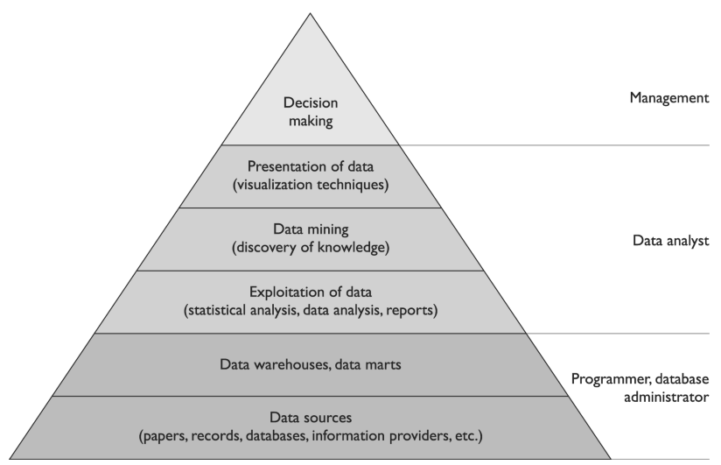
Data Mining

Slide 99
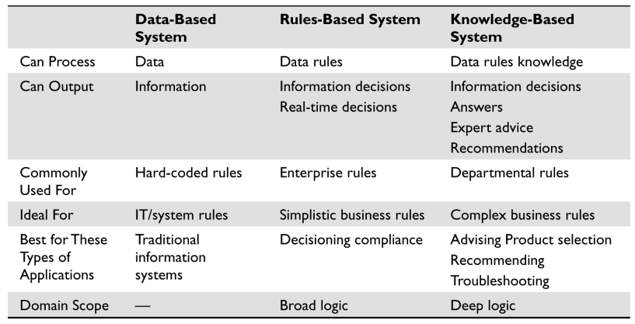

Slide 100
Key Terms
Record -- A collection of related data items.
File -- A collection of records of the same type.
Database -- A cross-referenced collection of data.
DBMS -- Manages and controls the database.
Tuple -- A row in a two-dimensional database.
Attribute -- A column in a two-dimensional database.
Primary key -- Columns that make each row unique. (Every row of a table must include a primary key.)
View -- A virtual relation defined by the database administrator in order to keep subjects from viewing certain data.
Foreign key -- An attribute of one table that is related to the primary key of another table.
Cell -- An intersection of a row and a column.
Schema -- Defines the structure of the database.
Data dictionary -- Central repository of data elements and their relationships.

Slide 101
Key Terms…
Database A collection of data stored in a meaningful way that enables multiple users and applications to access, view, and modify data as needed.
Database management system (DBMS) Enforces access control restrictions, provides data integrity and redundancy, and sets up different procedures for data management manipulation.
Relational database model Uses attributes ( columns) and tuples (rows) to contain and organize information.
Hierarchical data model Combines records and fields that are related in a logical tree structure.
Object-oriented database Designed to handle a variety of data (images, audio, documents, video), which is more dynamic in nature than a relational database.
Object-relational database (ORD) Uses object-relational database management system (ORDBMS) and is a relational database with a software front end that is written in an object-oriented programming language.
Schema Database structure that is described in a formal language supported by the database management system (DBMS). It is used to describe how data will be organized.
Data dictionary A central collection of data element definitions, schema objects, and reference keys.
Primary key An identifier of a row and is used for indexing in relational databases.
Rollback An operation that ends a current transaction and cancels all the recent changes to the database until the previous checkpoint/ commit point.
Two-phase commit A mechanism that is another control used in databases to ensure the integrity of the data held within the database.
Cell suppression A technique used to hide specific cells that contain sensitive information.
Noise and perturbation A technique of inserting bogus information in the hopes of misdirecting an attacker or confusing the matter enough that the actual attack will not be fruitful.
Data warehousing Combines data from multiple databases or data sources into a large database for the purpose of providing more extensive information retrieval and data analysis.
Data mining Otherwise known as knowledge discovery in database (KDD), which is the process of massaging the data held in the data warehouse into more useful information.

Slide 102
Application Security
Auditor Perspective – Courtesy of Mike Schiller

Slide 103
Application Security Best Practices
Apply Defense in Depth
Use a Positive Security Model
Fail Safely
Run with Least Privilege
Avoid Security by Obscurity
Keep Security Simple
Detect Intrusions and Keep Logs
Establish Secure Defaults
Notes:
Apply Defense in Depth - Layered approaches provide more security over the long term than one complicated mass of security architecture. You might, for example, use access control lists (ACLs) on the networking and firewall equipment to only allow necessary traffic to reach the application. This approach significantly lowers the overall risk of compromise to the system the application is running on because you quickly eliminate access to services, ports, and protocols that would otherwise be accessible to compromise.
Use a Positive Security Model - Positive security models only allow what is on the list, excluding by default everything else. However, negative security models allow everything by default, eliminating only those items you know are bad. This is the challenge to antivirus programs, which you must constantly update to keep up with the number of new possible attacks (viruses) that could affect you. The problem with this model, if you are forced to use it, is that you absolutely must keep the model updated. Even with the model updated, a vulnerability could exist that you don’t know about and your attack surface is much larger than if you used a positive security model.
Fail Safely - There are basically three responses when an application fails. You can allow, block, or error. In general, application errors should fail in the same manner as a disallow operation as viewed from the end user. This is important because then the end user doesn’t have additional information to use that may help them compromise the system.
Run with Least Privilege - The principle of least privilege mandates that accounts have the least amount of privilege possible to perform their activity. This encompasses user rights, resource permissions such as CPU limits, memory, network, and file system permissions.
Avoid Security by Obscurity - Obfuscating data, or hiding it instead of encrypting it, is a very weak security mechanism, especially for an application. If a human was able to figure out how to hide the data, there is a good chance that another person is going to learn how to recover the data. A real world example is how some people will hide a key to their house under the doormat. Never obfuscate critical data that can be encrypted or never stored in the first place.
Keep Security Simple - Simple security mechanisms are easy to verify and easy to implement correctly. Developers should avoid the use of double negatives and complex architectures when a simpler approach would be faster and simpler. Don’t confuse complexity with layers. Layers are good. Complexity isn’t.
Detect Intrusions and Keep Logs - Applications should have built-in logging that’s protected and easily read. Logs help you troubleshoot issues and just as importantly help you track down when or how an application might have been compromised.
Establish Secure Defaults - Your applications should arrive to you or be presented to the users with the most secure default settings possible and still allow business to function.

Slide 104
Application Control Categories
Data Input Controls
Interface Controls
Audit Trails
Access Controls
Software Change Controls
Backup and Recovery
Data Retention and Classification
Infrastructure Controls

Slide 105
Data Input Controls
Prohibit alphanumeric characters in numeric fields.
Require input in the correct format (such as MMDDYY or HHMM) or transform input into the correct format.
Perform ‘reasonableness’ checks.
Prohibit invalid entries when there are finite choices.
Prohibit duplicate entries for data which is intended to be unique.
Notes:
Online transactions should perform up-front validation and editing in order to ensure the integrity of data before it is entered into the system’s files and databases.
Where applicable, transactions should perform ‘reasonableness’ checks on inputs. An example would be preventing users from reporting labor of more than 24 hours in a day or more than 60 minutes in an hour. Another example would be disallowing entry for time, costs, etc. for an employee who has been terminated or who is on LOA.
When there are a finite number of valid entries for a field, entries which are invalid should not be allowed. In other words, input screens should validate such things as cost centers, account numbers, product codes, employee numbers, etc. against the appropriate database(s) or file(s).
Duplicate entries should not be allowed for data which is intended to be unique. For example, the transaction should not allow a product code to be added to the product database if that code already exists on the database.

Slide 106
Data Input Controls
Perform ‘logic’ checks.
Prohibit execution until valid data is entered into all required fields.
Perform ‘calculation’ checks on inputs.
Implement programmed cutoff controls to prevent users from recording transactions in the wrong period.
Use error or exception reports when up-front validation is not possible.
Notes:
Where applicable, the transaction should perform ‘logic’ checks. For example, if there were a transaction used by ticket agents to record how many seats were sold on a flight and how many no-shows there were, the transaction should not allow the agent to input numbers indicating there were more no-shows than seats sold.
Each input screen generally has certain fields which are required in order for the transaction to be processed accurately. Execution of a transaction should not be allowed until valid data is entered into each of these fields.
Where applicable, transactions should perform ‘calculation’ checks on inputs. For example, the system should ensure that journal entry credits and debits balance to zero before processing a transaction. Another example would be a labor entry system where hours charged for the week need to add up to at least 40.
Programmed cutoff controls should be in place to help prevent users from recording transactions in the wrong period. In other words, the screen should not allow users to record transactions in prior accounting periods.
Error or exception reports allow any potential data integrity problems to be reviewed and corrected when it’s not feasible or practical to use input controls to perform up-front validation of data entered into the system. For example, while it may not be inherently wrong for an employee to enter 80 hours of overtime for one week into a labor system, this sort of unusual event should be captured on a report for review by the appropriate level of management.

Slide 107
Interface Controls
Ensure data is transmitted completely and accurately.
Generate control totals (e.g. hash totals, record counts and total amounts).
Generate exception or reconciliation reports for items that did not successfully transmit.
Secure data files that contain interface source or target information
Apply controls from Data Input Controls section and generate applicable exception reports.
Execute periodic ‘sync’ processes to detect any inconsistencies in data kept on multiple systems.
Notes:
When an application passes and/or receives data to/from other applications, controls need to be put in place which ensure the data is transmitted completely and accurately.
Control totals from interface transmissions should be generated and used by the system to determine whether the transmission completed accurately. If a problem is found, reports should be issued which notify the proper people of the problem. Some examples of control totals that may be applicable are hash totals, record counts, and total amounts (for numerical records). Another type of control total could flag missing record numbers when records are transmitted in a sequential fashion.
A hash total is an arbitrary total that has no value or meaning outside the context in which it was created. It is used only to validate the integrity of that data you are examining. For example, if you were auditing a batch processing system, you might compare the transactional amount total, the number of transactions, and a hash total that you “designed” such as the sum of account numbers… not the count, nut the sum. In other words, a sum (total) that has no meaning outside of your intended use. If you have already summed the account numbers (or dept numbers, or whatever you choose to use), then you can compare the hash total to your known total and it should provide assurance that the processing output is complete and that all data was input for processing. In a payroll application, it might be a sum of employee numbers. A method for ensuring the accuracy of processed data. It is a total of several fields of data in a file, including fields not normally used in calculations, such as account number. At various stages in the processing, the hash total is recalculated and compared with the original. If any data has been lost or changed, a mismatch signals an error.
MQ Series - Messages will be delivered once and once only, irrespective of errors and network problems.
The system should handle items that did not successfully transmit in such a manner that reports and/or processes enable these items to be resolved quickly and appropriately with audit trails as appropriate.
Data files that contain interface source or target information should be secured from unauthorized modifications. This may mean appropriate authentication controls, authorization controls, or encryption where necessary.
When it is not feasible to use control totals to verify accurate transmission of data, reconciliation reports should be generated which allow users to compare what was on one system to what was received on another system.
Where applicable, data validation and editing, as described in the Input Controls section, should be performed on data received from outside systems. Error/exception reports should be generated which allow any data integrity problems to be corrected.
In cases where the same data is kept in multiple databases and/or systems, ensure periodic ‘sync’ processes are executed to detect any inconsistencies in the data.

Slide 108
Audit Trails
Capture data on changes.
Old and new values, who made the change, and when it was made.
Secure audit trail data.
Retain audit trails to aid investigations into errors or inappropriate activities.
Provide a means to trace a transaction or piece of data from the beginning to the end of the process.
Notes:
Audit trails are useful for troubleshooting and helping to track down possible breaches of your application.
Information should be captured when key data elements are changed. This information should include in most cases the original and new values of the data, who made the change, and when it was made.
This information should be kept in a secured log in order to prevent unauthorized updates.
The logs should be retained for a reasonable period of time, such as three or six months, in order to aid investigations into errors or inappropriate activities.
The system should provide a means to trace a transaction or piece of data from the beginning to the end of the process enabled by the system. This is important in order to verify that the transaction was fully processed and to pinpoint any errors or irregularities in the processing of that data.

Slide 109
Access Controls
Authentication capabilities
Password controls – complexity, aging, lockout
Authorization capabilities
Administrator function
Account management processes
Suspension of access after termination or job change
Workflow approvals
Timeout
Encryption
Segregation of duties
Notes:
Authentication
Password controls – complexity, aging, lockout
Authorization - it should be possible to specify which specific transactions and datasets or files a system user will access. In general, it should also be possible to specify what level of access (display, update, delete, etc.) that the user will receive to application resources.
Administrator function - The user of this function should have the ability to add, delete, or modify user access to the application system and its resources. The security mechanism should also provide the ability to tightly control who has access to this administrator function. There should also be a mechanism that provides the system’s security administrator with the ability to view who has access to the system and what level of access they have.
Account management processes
Automatic suspension of access after termination or job change
Workflow approvals - The application’s security mechanism should support granular controls over who can perform what approval processes, and then lock data that has been formally approved from modification by a lower authority. For example, if there is a need for ‘sign-off’ of journal entries before they can be passed on to the general ledger, the system’s security mechanism should provide a means for defining who is authorized to perform this sign-off. Any data which has been through this sort of approval process should be ‘locked’ from any further modifications.
Timeout
Encryption
Segregation of duties
Application developer access to production data

Slide 110
Software Change Controls
Prohibit developers from directly updating production code.
Require developers to check out code which they wish to modify.
Prevent concurrent check-outs.
Require sign-off before code will be moved into production.
Sign-off by someone other than the person who developed or modified the code.
Minimize sign-off authorization.
Prevent code from being modified after it has been signed-off but before it has been moved to production.
‘Version’ software.
Require evidence of testing, code walk-throughs, and adherence to software development guidelines before sign-off.
Test modifications in a test environment using test data.
Notes:
It should not be possible for developers to directly update production code.
Verify with the developers that the software change mechanism requires developers to check out code which they wish to modify. If another developer wishes to modify the same code while it is still checked out, he or she should be prevented from doing so.
The software change mechanism should require sign-off before code will be moved into production. The system should require that this sign-off be performed by someone other than the person who developed or modified the code.
Should allow for specific people to be authorized to perform sign-off on the system’s programs.
Evaluate controls in place to prevent code from being modified after it has been signed-off but before it has been moved to production.
Ensure the software change mechanism ‘versions’ software so that past versions of the code can be retrieved if necessary.
Determine whether the software change process requires evidence of testing, code walk-throughs, and adherence to software development guidelines. These should occur before the approver signs off on the code.
Testing of any software development or modifications should take place in a test environment using test data.

Slide 111
Backup and Recovery
Perform BIA to determine RTO and RPO.
Take periodic back-ups and store off-site in a secured location.
Should be aligned with RTO and RPO.
Back up application code and store off-site in a secured location, along with any tools necessary for compiling and using the code.
Document detailed recovery procedures that define what tasks are to be performed, who is to perform those tasks, and the sequence in which they are to be performed.
Test recovery from backup tapes using the documented recovery procedures periodically.

Slide 112
Data Retention and Classification
Archive and retain data in accordance with business, tax and legal requirements.
All application data should be assigned a business owner and this owner should classify the data (e.g. public, internal use only, or confidential).

Slide 113
Infrastructure Controls
Physical security
Environmental controls
Network security
Operating system security
Database security
Middleware security

Slide 114
Software System Development

Slide 115
System Development
Security is most effective if it is planed and designed from the beginning, not added on as an after though later.
Security should be part of the product’s lifecycle from the beginning.
Cheaper
More secure
A security plan should be included for the product and that plan should be referenced all through the software development lifecycle
more

Slide 116
System Development
There are different types of SD models however they usually break down into the following phases, each of which we will talk about.
Project initialization
Functional design analysis and planning
System design specifications
Software Development
Installation/Implementation
Operation/Maintenance
Disposal

Slide 117
SD Step 1-Project Initialization
Why are we building the product?
What is the scope of the product?
Conceptual definition of the product is defined, evaluate other products that will be similar.
Determine necessary resources and timeline of development
Determine security needs/objectives create security framework.
Initial risk analysis should be done this will change as the product is developed.
Get management to sign off on project development

Slide 118
SD Step 2-Functional Design Analysis and Planning
In this phase a project plan is developed and security activities and checkpoints should be developed as part of that plan.
Resources should be indentified, test schedules start to form, as well as evaluation criteria (to test security functionality)
Design document is created to explain the functionality of the product. Now is the time to understand what this will or will not be able to do and add or subtract functionality.

Slide 119
SD Step 3-System Design Specification
Start to figure out HOW the product will provide the required functionality.
This is where details start to come out on what mechanisms will be used to accomplish the goals.
Specifics of how to provide the necessary functionality and security (ex. what are the details of how authentication will be accomplished, what type of encryption be used will be addressed at this stage before coding begins)
From a security standpoint, access control mechanisms will be chosen, rights and permissions defined, encryption algorithms chosen, how to handle sensitive data is determined etc.
The environment that the product will run in needs to be considered (Unix, Windows, stand alone or network access, etc)

Slide 120
SD Step 4-Software Development
Code is developed at this stage.
Developers should code in a way that does not permit software compromises. (proper secure software development training is required for this)
Input validation should happen
Code to prevent covert channels should be included.
Everything should be clearly documented.
Formal and informal testing should occur
more

Slide 121
SD Step 4-Software Development
Testing should be carried out by a separate group of people (not the programmers) (separation of duties)
Software should be attacked to ensure it is secure.
Backdoors/maintenance hooks should be removed
Software should be tested and fixed, and tested again, until everyone is satisfied and the product is ready to be released.

Slide 122
Verification vs. Validation
Verification determines if the product accurately represents and meets the specifications. After all, a product can be developed that does not match the original specifications, so this step ensures the specifications are being properly met.
Validation determines if the product provides the necessary solution for the intended real-world problem. In large projects, it is easy to lose sight of the overall goal. This exercise ensures that the main goal of the project is met.

Slide 123
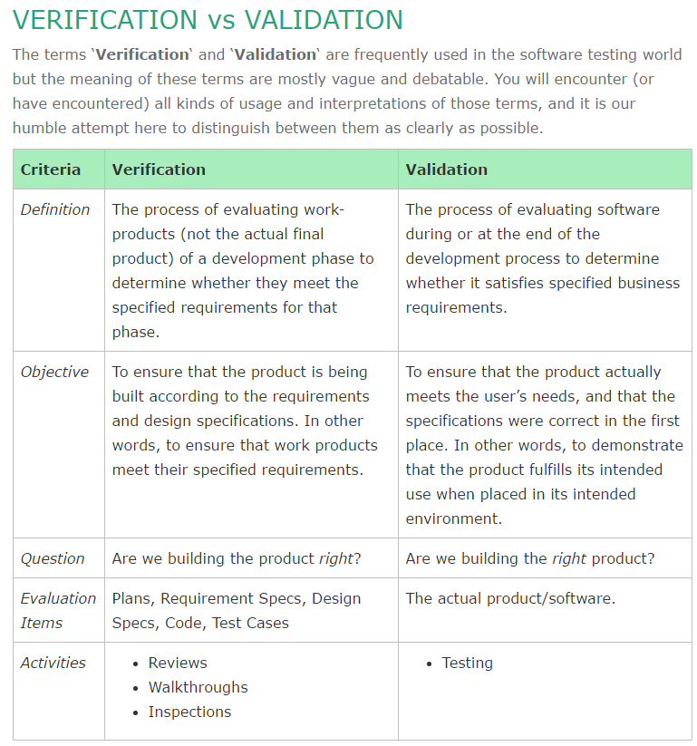
http://softwaretestingfundamentals.com/verification-vs-validation/

Slide 124
Testing
Obviously software needs to be thoroughly tested. There are 4 testing terms to be aware of for the exam. This happens during software development (Step 4) and before actual implementation (Step 5)
Unit Testing – test each small component of a software system individually and thoroughly
Integration Testing – test that the components work together correctly
Acceptance Testing – Ensuring that code meets the customers requirements
Regression Testing – retesting after any change to ensure functionality performance and protection.

Slide 125
SD Step 5-Installation/Implementation
Install the software
PROPERLY configure the software.
Functionality and performance tests should occur, as well as security tests.
System should be certified and accredited at this point before being put into production.
more

Slide 126
SD Step-5 Installation/Implementation
Auditing should be enabled and this software and systems should be considered as part of the Business Continuity Plan and that plan should be updated to include this new application if necessary.

Slide 127
SD Step 6-Operation and Maintenance
Configure new system and place it into production. Ensure the security controls provided are PROPERLY configured
Conduct vulnerability assessments/tests, patch system when required, audit system use.
If any major changes to the product occur, you might have to redo a risk analysis, re-certify and re-accredit the system.

Slide 128
SD Step 7-Disposal
When the system is to be retired, you may need to backup the data, you may also need to securely destroy the data, depending on your environment and the sensitivity of the data on your system.

Slide 129
Review
After the completion of a project the team should gather to review the project and discuss what went well, what went wrong and needs to be improved for the next project.
This should be a structured event with someone leading the meeting. People need to feel relaxed and free to speak their minds so we can learn as much as we can for the next project.

Slide 130
Software Development Methodologies

Slide 131
Software Development Methods
You should probably understand the different software development methods.
Waterfall – classic method with defined phases and formal reviews and documentation before moving from one stage to another.
Spiral – builds on waterfall, but with an emphasis on risk analysis, prototype, and simulations at different phases. Periodically revisits previous stages to update and verify design requirements

Slide 132
Software Development Methods
Joint Analysis Development – team approach in a workshop type environment
Rapid Application Development – a method of determining user requirements and developing system quickly to satisfy immediate needs
Clean room – approach that attempts to prevents errors by following structured and formal methods of developing and testing. This approach used for high-quality and critical applications that will be put though a strict certification process.

Slide 133
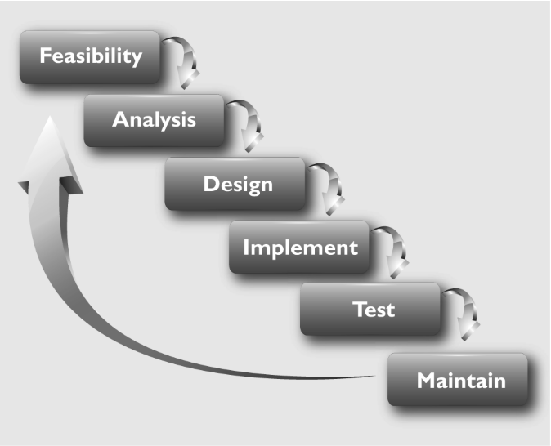
Waterfall
The Waterfall model uses a linear-sequential life-cycle approach.
Each phase must be completed in its entirety before the next phase can begin.
At the end of each phase, a review takes place to make sure the project is on the correct path and if the project should continue.
Notes:
This is a very rigid approach that could be useful for smaller projects that have all of the requirements fully understood, but it is a dangerous model for complex projects, which commonly contain many variables that affect the scope as the project continues.
Harris, Shon (2012-11-08). CISSP All-in-One Exam Guide, 6th Edition (Kindle Locations 21806-21808). McGraw-Hill Education. Kindle Edition.

Slide 134
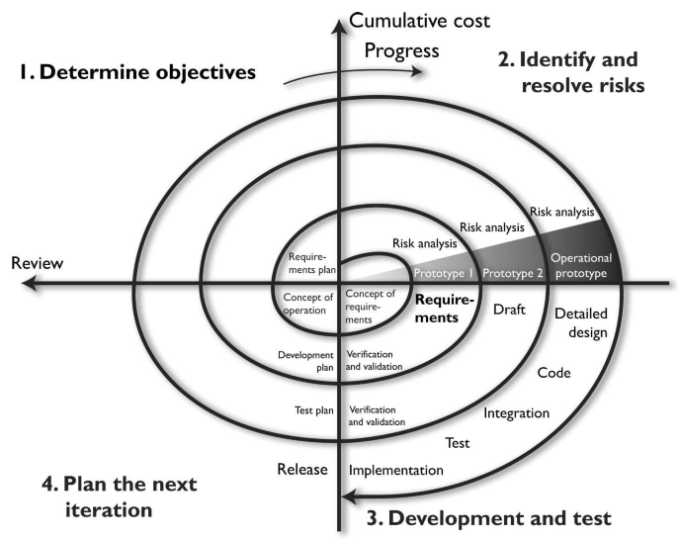
Spiral Model
The iterative approach provided by the Spiral model allows new requirements to be addressed as they are uncovered.
Each prototype allows for testing to take place early in the development project, and feedback based upon these tests is integrated into the following iteration of steps.
The risk analysis ensures that all issues are actively reviewed and analyzed so that things do not “slip through the cracks” and the project stays on track.
Notes:
This is a very rigid approach that could be useful for smaller projects that have all of the requirements fully understood, but it is a dangerous model for complex projects, which commonly contain many variables that affect the scope as the project continues.
Harris, Shon (2012-11-08). CISSP All-in-One Exam Guide, 6th Edition (Kindle Locations 21806-21808). McGraw-Hill Education. Kindle Edition.

Slide 135
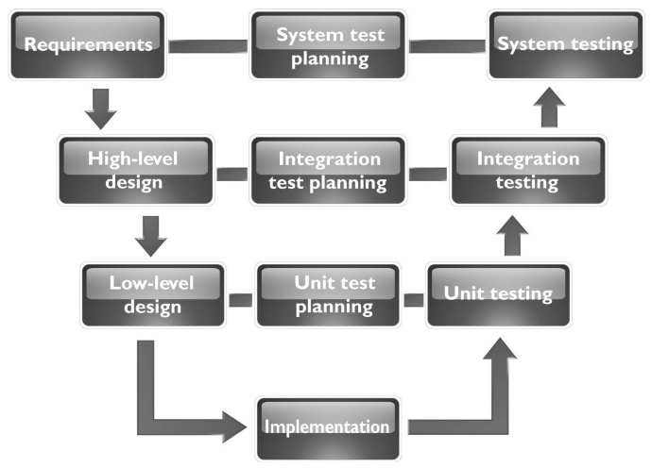
V-Shaped Model (V-Model)
The V-model was developed after the Waterfall model.
Instead of following a flat linear approach in the software development processes, it follows steps that are laid out in a V format.
This model emphasizes the verification and validation of the product at each phase and provides a formal method of developing testing plans as each coding phase is executed.
Notes:
The V-shaped model is still very rigid, as is the Waterfall model . This level of rigidness does not allow for much flexibility; thus, adapting to changes is more difficult and expensive. This model does not allow for the handling of events concurrently, it does not integrate iterations of phases, and it does not contain risk analysis activities as later models do. This model is best used when all requirements can be understood up front and potential scope changes are small.
Harris, Shon (2012-11-08). CISSP All-in-One Exam Guide, 6th Edition (Kindle Locations 21816-21819). McGraw-Hill Education. Kindle Edition.

Slide 136
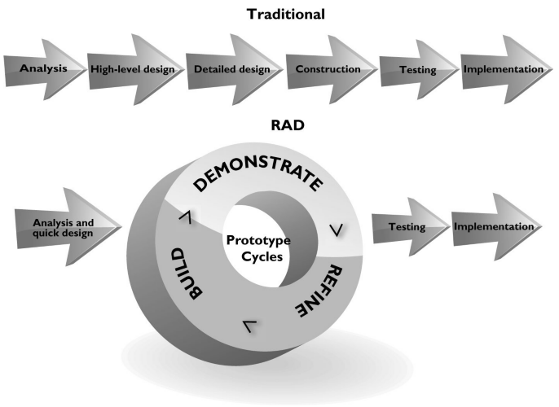
Rapid Application Development (RAD) Model
The main reason that the RAD model was developed was that by the time software was completely developed following other models, the requirements changed and the developers had to “go back to the drawing board.”
If a customer needs you to develop a software product and it takes you a year to do so, by the end of that year the customer’s needs for the software have probably advanced and changed.
The RAD model allows for the customer to be involved during the development phases so that the end result maps to their needs in a more realistic manner.
Notes:
The V-shaped model is still very rigid, as is the Waterfall model . This level of rigidness does not allow for much flexibility; thus, adapting to changes is more difficult and expensive. This model does not allow for the handling of events concurrently, it does not integrate iterations of phases, and it does not contain risk analysis activities as later models do. This model is best used when all requirements can be understood up front and potential scope changes are small.
Harris, Shon (2012-11-08). CISSP All-in-One Exam Guide, 6th Edition (Kindle Locations 21816-21819). McGraw-Hill Education. Kindle Edition.

Slide 137
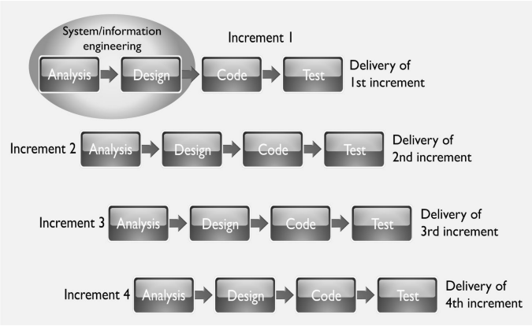
Incremental Development Model

Slide 138
Agile Model
Umbrella term for several development methodologies.
Focuses not on rigid, linear, stepwise processes, but instead on incremental and iterative development methods that promote cross-functional teamwork and continuous feedback mechanisms.
This model is considered “lightweight” compared to the traditional methods that are “heavyweight,” which just means this model is not confined to a tunneled vision and overly structured approach.
It is nimble and flexible enough to adapt to each project’s needs.
The industry found out that even an exhaustive library of defined processes cannot handle every situation that could arise during a development project. So instead of investing time and resources into big upfront design analysis, this model focuses on small increments of functional code that are created based upon business need.

Slide 139
Summary of Models
Break and Fix -- No real planning up front. Flaws are reactively dealt with after release with the creation of patches and updates.
Waterfall -- Sequential approach that requires each phase to complete before the next one can begin. Difficult to integrate changes. Inflexible model.
V-model -- Emphasizes verification and validation at each phase and testing to take place throughout the project, not just at the end.
Prototyping -- Creating a sample or model of the code for proof-of-concept purposes.
Incremental -- Multiple development cycles are carried out on a piece of software throughout its development stages . Each phase provides a usable version of software.
Spiral -- Iterative approach that emphasizes risk analysis per iteration. Allows for customer feedback to be integrated through a flexible evolutionary approach.
Rapid Application Development -- Combines prototyping and iterative development procedures with the goal of accelerating the software development process.
Agile -- Iterative and incremental development processes that encourage team-based collaboration . Flexibility and adaptability are used instead of a strict process structure.

Slide 140
SDLC

Slide 141
Computer Aided Software Engineering
CASE – is the use of tools to create and manage software. A CASE tool is aimed at supporting one or more SE tasks and activities.
development environments
version control
code analyzers
automatically code creation tools

Slide 142
Prototyping
Quick code written to show the customer where the project is going to ensure that the project will satisfy the customers requirements. Prototyping does not have to be actual code, it could be a graphical walk through of displays, flowcharts, logic etc for the customer to walk through.

Slide 143
Change Control
Change control is important both before production and after production. If customers are allowed to request changes (without charge) after the project is started they can make the project go over budget and the company lose money (this is a risk/threat). Change control after production focuses on how these changes will affect the configuration, functionality and security and stability of a product. The following are necessary steps for a change control process.

Slide 144
Change Control steps
Make formal request for change
Analyze the request
Develop implementation strategy
Calculate the costs of the change
Review security implications
Record the change request
Submit the request for approval
Develop the change
Recode product, add/subtract functionality
Link these code change to the formal request
Submit software for testing and QA
Repeat until changes are ok
Make version changes
Report results to management
(Recertification/reaccreditation if necessary)

Slide 145
Capability Maturity Model
CCM describes procedures, principles and practices to underlie software development process maturity.
The ideas is to help organizations develop standardized approaches and development practices to ensure the can consistently success with projects, and provide higher quality software at a lower cost.
The model offers a layered framework that allows a company to continuously improve their SD practices, the 5 levels are given on the next slide

Slide 146
CMM
Initial – development process is ad-hoc, not structured, no effective management plans and procedures. No assurance of consistency and quality is unpredictable
Repeatable – a formal management structure, change control and QA are in place. Company can repeat processes through projects. However no formal processes exist yet.
Defined – formal procedures are in place that outline and define processes carried out in each phase. The organization has a way to allow for quantitative process improvement
(more)

Slide 147
CMM
Managed – The company has formal processes in place to collect and analyze qualitative data, and metrics are defined and fed into the process improvement program
Optimizing – The company has budgeted and integrated plans for continual process improvement.

Slide 148
Software Escrow
Many companies have software that was developed by 3rd parties, and rely on that company for the code and support. This dependancy on a 3rd party is a large IRM risk .
Software Escrow attempts to mitigate this problem.

Slide 149
Application Development Methodology
Code is written in a human readible high level language like C or Java (source code).
CPUs do NOT understand high level code.
High level code must be compiled into native CPU code (machine language)
Machine Language Example next page

Slide 150
Application Development Methodology
There are different type of turning source code into executable code
Assembling – turn assembly language into machine code. Assembly language code is the english equivalent of machine language, however it is not easily understood by modern humans.
Assembly language is SPECIFIC to the CPU that the machine is running on.
Assembled code is 1-1 to machine code and machine code can be disassembled and returned back to the original assembly

Slide 151
Programming Languages and Concepts
Assemblers, Compilers, Interpreters

Slide 152
Key Terms
Machine language -- A set of instructions in binary format that the computer’s processor can understand and work with directly.
Assembly language -- A low-level programming language that is the mnemonic representation of machine-level instructions.
Assemblers -- Tools that convert assembly code into the necessary machine-compatible binary language for processing activities to take place.
High-level languages -- Otherwise known as third-generation programming languages, due to their refined programming structures, using abstract statements.
Very high-level languages -- Otherwise known as fourth-generation programming languages and are meant to take natural language-based statements one step ahead.
Natural languages -- Otherwise known as fifth-generation programming languages, which have the goal to create software that can solve problems by themselves. Used in systems that provide artificial intelligence.

Slide 153
Key Terms
Compilers -- Tools that convert high-level language statements into the necessary machine-level format (. exe, .dll, etc.) for specific processors to understand.
Interpreters -- Tools that convert code written in interpreted languages to the machine-level format for processing.
Garbage collector -- Identifies blocks of memory that were once allocated but are no longer in use and deallocates the blocks and marks them as free.
Abstraction -- The capability to suppress unnecessary details so the important, inherent properties can be examined and reviewed.
Polymorphism -- Two objects can receive the same input and have different outputs.
Data modeling -- Considers data independently of the way the data are processed and of the components that process the data. A process used to define and analyze data requirements needed to support the business processes.

Slide 154
Key Terms
Cohesion -- A measurement that indicates how many different types of tasks a module needs to carry out.
Coupling -- A measurement that indicates how much interaction one module requires for carrying out its tasks.
Data structure -- A representation of the logical relationship between elements of data.

Slide 155
Programming Languages and Concepts
Object Oriented Concepts

Slide 156
Key Terms
Distributed Computing Environment (DCE) -- The first framework and development toolkit for developing client/ server applications to allow for distributed computing.
Common Object Request Broker Architecture (CORBA) -- Open object-oriented standard architecture developed by the Object Management Group (OMG). The standards enable software components written in different computer languages and running on different systems to communicate.
Object request broker (ORB) -- Manages all communications between components and enables them to interact in a heterogeneous and distributed environment. The ORB acts as a “broker” between a client request for a service from a distributed object and the completion of that request.
Component Object Model (COM) -- A model developed by Microsoft that allows for interprocess communication between applications potentially written in different programming languages on the same computer system.

Slide 157
Key Terms
Object linking and embedding (OLE) -- Provides a way for objects to be shared on a local computer and to use COM as their foundation. It is a technology developed by Microsoft that allows embedding and linking to documents and other objects.
Java Platform, Enterprise Edition (J2EE) -- Is based upon the Java programming language, which allows a modular approach to programming code with the goal of interoperability. J2EE defines a client/ server model that is object oriented and platform independent.
Service-oriented architecture (SOA) -- Provides standardized access to the most needed services to many different applications at one time. Service interactions are self-contained and loosely coupled, so that each interaction is independent of any other interaction.
Simple Object Access Protocol (SOAP) -- An XML-based protocol that encodes messages in a web service environment.

Slide 158
Key Terms
Mashup -- The combination of functionality, data, and presentation capabilities of two or more sources to provide some type of new service or functionality.
Software as a Service (SAAS) -- A software delivery model that allows applications and data to be centrally hosted and accessed by thin clients, commonly web browsers. A common delivery method of cloud computing.
Cloud computing -- A method of providing computing as a service rather than as a physical product. It is Internet-based computing, whereby shared resources and software are provided to computers

Slide 159
More terms and concepts you need to understand

Slide 160
Expert Systems
An expert system or knowledge based system uses Artificial intelligence to solve problems. They try to emulate human logic to solve problems as if an expert human was there.
Collect knowledge into a database
Use rule-based programming (if-then logic)
Uses an inference engine to match facts against patterns and determine which rules are applicable.
An example of an expert system might be on that takes information about a patients medical history and current symptoms along with questions to determine which ailments a patient might be suffering from.

Slide 161
Artificial Neural Networks
Computer model based on the neural structure of the brain. Attempts to learn.
As information is used more and more connections between units grow and strengthen like how human minds work.
Fuzzy logic is used (rather than true or false, degrees of truth or falseness/rating)
Massive trial and errors decision making is used.

Slide 162
Web Security

Slide 163
Web Security
The web (HTTP) is the application that brought the internet out of academic and research obscurity and caused it to be the phenomenon that it is today.
The web is highly commercialized now and that brings dangers.

Slide 164
Web Security
Web dangers:
People may try to use your online presence to cause you harm.
Vandalism – deface your site, ruin your reputation
Financial fraud – attempt to steal web based goods or services
Privileged access – hack your web server to get access to something more important
Theft of personal information – access your clients information, identity theft
Theft if intellectual property – steal company secrets
Denial of service – stop you from carrying out online transaction, and cost you money!

Slide 165
Web Security
There are multiple vulnerabilities and threats that can be exploited to accomplish any of the previous actions. We will talk about each of these issues over the next couple slides
Information gathering
Administrative interfaces
Authentication and access control
Configuration management
Input validation
Parameter validation
Session management

Slide 166
Input Validation
Software must validate input and ensure that it is appropriate and does not pose a security risk before operating on the input.
Attackers may try to hide their actions using.
Path or directory traversal
Unicode encoding
URL encoding
Buffer Overflows
You should be aware of these and understand how they operate (pg 1008) we will explore these in the next couple slides.
(more)

Slide 167
Input Validation
Path of directory traversal tries to access data on a web server that is not intended to be shared. (data outside of the shared directories)
Web servers are configured to serve information out of the web root or document root directory which is a specific directory on the system with files for public access.

Slide 168
Path Traversal
Assume http://www.myserver.com has the document root set to /var/web/html
The request http://www.myserver.com/index.html would try to access the file /var/web/html/index.html
What would http://www.myserver.com/index.html/../../../etc/passwd try to access?

Slide 169
URL encoding
Good software should filter out request like I just showed. For example if a security product filtered out parts of the URL like “../.” One attempt to get around this is to use special URL encoded characters
http://www.myserver.com/%2E%2E/%2E%2E/%2E%2E/etc/passwd
%2E = . so it’s the same as
http://www.myserver.com/../../../etc/passwd

Slide 170
Unicode Encoding
Similar to Unicode encoding, but uses special Unicode characters rather than URL encoding.
http://www.myserver.com/%C0AE%C0AE/%C0AE%C0AE/%C0AE%C0AE/etc/passwd
%C0AE = . so it’s the same as
http://www.myserver.com/../../../etc/passwd

Slide 171
Parameter Validation
Similar to input validation, but are specific to the environment and assume the user cannot alter them (ex. Environmental variables)

Slide 172
Session Management
HTTP is a stateless protocol as such there must be a way of managing and passing state information between the client and the server this is usually done with cookies which create a sessions between the user and the web application.
This session management can be attacked to hijack sessions. The next slide discusses best practices for sessions management.

Slide 173
Session Management Best Practices
Sessions details should be stored on the server, never passed by the client
The client should pass a session ID which the server uses to recover the state from it own database
Session IDs should be random
Session IDs should be encrypted
Session IDs should have a maximum lifetime to avoid replay attack

Slide 174
Key Terms
Information gathering -- Usually the first step in an attacker’s methodology, in which the information gathered may allow an attacker to infer additional information that can be used to compromise systems.
Server side includes (SSI) -- An interpreted server-side scripting language used almost exclusively for web-based communication. It is commonly used to include the contents of one or more files into a web page on a web server. Allows web developers to reuse content by inserting the same content into multiple web documents.
Client-side validation -- Input validation is done at the client before it is even sent back to the server to process.

Slide 175
Key Terms
Cross-site scripting (XSS) -- An attack where a vulnerability is found on a web site that allows an attacker to inject malicious code into a web application.
Parameter validation -- The values that are being received by the application are validated to be within defined limits before the server application processes them within the system.
Web proxy -- A piece of software installed on a system that is designed to intercept all traffic between the local web browser and the web server.
Replay attack -- An attacker capturing the traffic from a legitimate session and replaying it with the goal of masquerading an authenticated user.

Slide 176
Client side security issues

Slide 177
Mobile Code
So we talked about concerns with server side applications. What about client side issues? To make the web experience more functional and friendly often code runs directly on your web browser or personal computer, this happens via mobile code that is code that your computer downloads from a server and executes on your workstation.

Slide 178
Mobile Code
Mobile Code types we will discuss
Java
Active X
Javascript

Slide 179
Java
Java - The original mobile code designed by Sun Microsystems
Purpose/idea
Byte code
Java virtual machine
Applets
Sandbox
Signed vs. unsigned applications.

Slide 180
Active X
Microsoft mobile code based on COM/DCOM
Called active X controls
Security Level of browser determines whether or not to run active X
Active X can interact with the system. There is no sandbox
ActiveX controls can be digitally signed (authenticode)

Slide 181
Digitally Signed Software?
If mobile code is digitally signed, is it always safe to run?
What does digitally signing code provide the end user?

Slide 182
Javascript
Javascript (developed by Netscape) is mobile code that runs in the browser to make the web sessions more functional and interactive
Only runs in the browser
Can access browser information including cookies
Can rewrite data in the browser
Cross Site Scripting (XSS) is a common attack using Javascript to perform many undesirable actions, the most common is to steal session cookies for sessions hijacking.

Slide 183
Malware

Slide 184
Malware
Malware – You should understand what malware is and the basic types of malware and their attributes. Symptoms of malware may include
File size increase
Disk or CPU activity
Change of timestamps on files
Sudden increase of hard drive space
Strange activity by applications
Increase in network activity
Slow computer
Now to look at the types of Malware

Slide 185
Malware
The types of malware we will discuss in the next couple slides are
Viruses
Trojans
Worms
Logic Bombs
SPAM -not malware, but a method of malware distribution

Slide 186
Viruses
The original malware.
Operation
Requires human intervention to spread and attack
Types
Program Virus
Boot sector virus
Multipart virus – (infects both boot sector and executables)
Macro virus
Stealth virus – tries to hide itself from anti-virus software
Polymorphic virus – creates multiple different copies of itself in different ways to defeat detection
Self-garbling virus – like polymorphic, but alters itself with each generation.
MEME virus – not real virus, but chain letters, hoaxes etc

Slide 187
Virus Countermeasures
Countermeasures
Never run code if you don’t know what or where that executable has been.
Run anti-virus software on all workstations and major servers that accept incoming data to users (email, instant messaging, web proxies)

Slide 188
Anti-Virus Software
Anti-virus software tries to detect and stop viruses.
Types
Signature based
Heuristic
Strengths and weaknesses of each
which can possibly stop a 0day?

Slide 189
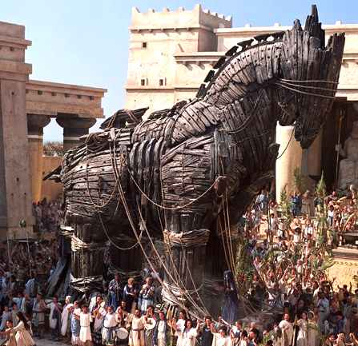
Trojan

Slide 190
Trojan
Like the Trojan Horse, a Trojan program seems like a gift. Pretends to be some useful program, and it even might do something useful initially. Howver it’s purpose is to deliver it’s malware payload.
Countermeasures
User Education
Don’t run software that you are not familiar with and that you don’t have original distribution media for.
Beware of email attachments that want to be run.
Software Signing
Anti-virus software to detect known Trojans

Slide 191
Worms
A worm has the ability to actively spread on it’s own unlike a virus that simply copies itself into other executables.
self-propagates
It might try to scan networks for known security weaknesses and “hack” machines as a method of spreading.
May email itself to others

Slide 192
Famous Worm Attacks
Morris Worm – First known worm
Simply spread didn’t do anything else
Did eat up a lot of CPU and network bandwidth, brought internet to a halt in 1988.
Did password guessing and auto-hacking
Code Red
Attacked IIS, using a buffer overflow, targeted other IIS servers
Nimba
5 methods of propagation
Email, network shares, compromised web sites, IIS holes, and backdoors from other worms.

Slide 193
Worm Countermeasures
Counter measures
Remove un-necessary services
Patch OS and applications
Beware of email attachments that want to be run.

Slide 194
Logic Bombs
Logic Bomb
Countermeasures
Inventory all software and keep checksums (File Integrity Verification Software)
(tripwire)

Slide 195
Anti-malware best practices
Install anti-virus on all computers
Have an automated method of updating virus signatures
Do not allow users to disable anti-virus scanning
External disks should be immediately scanned.
Disable “auto play” on USB and CDroms
Backup files should be scanned
Use network antivirus filters (email servers, proxy servers)
Make virus scanning a scheduled task on all computers
Use dynamic anti-virus scanning (real time file access)
Users should not be able to install software (especially on servers or critical systems)

Slide 196
SPAM
SPAM is annoying.
Spam wastes time and resources.
Spam can spread viri, trojans and worms.
SPAM can cause HR problems (nude images etc)
Spam filtering concepts
False positives
False negatives
Rules
Bayesian filtering – predicting probability via mathematical analysis.

Slide 197
Malware
For the exam you should be able to
define what malware is
what symptoms of malware are
be able to understand and discriminate between the types of malware their characteristics and countermeasures.
Understand the relationship between malware and SPAM

Slide 198
Buffer Overflows
What are they? What are the attributes of a buffer overflow?
NOTE SERIOUS LIBERTIES have been taken with the example slides of a buffer overflow to simplify the attack so it’s easier to understand. In reality it’s more complicated than shown

Slide 199
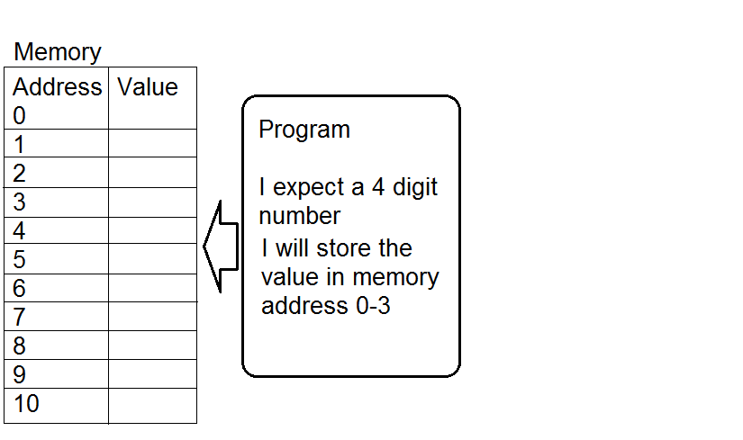
Buffer Overflow

Slide 200
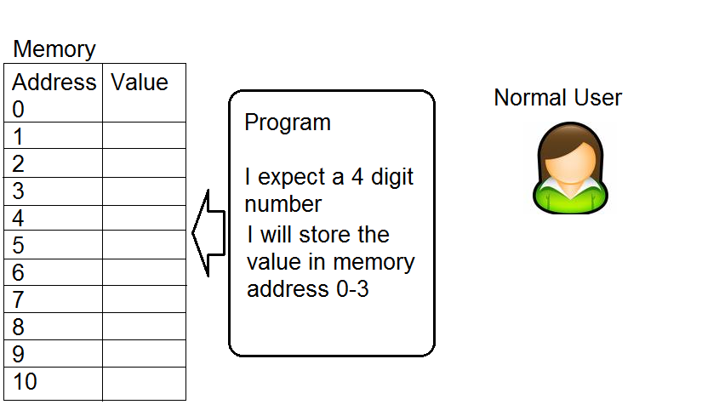
Buffer Overflow

Slide 201
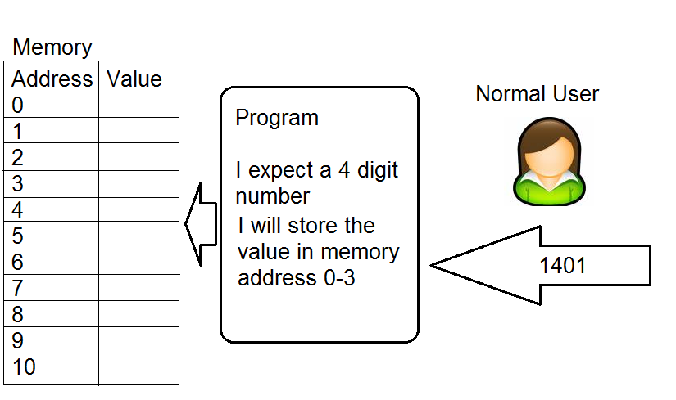
Buffer Overflow

Slide 202
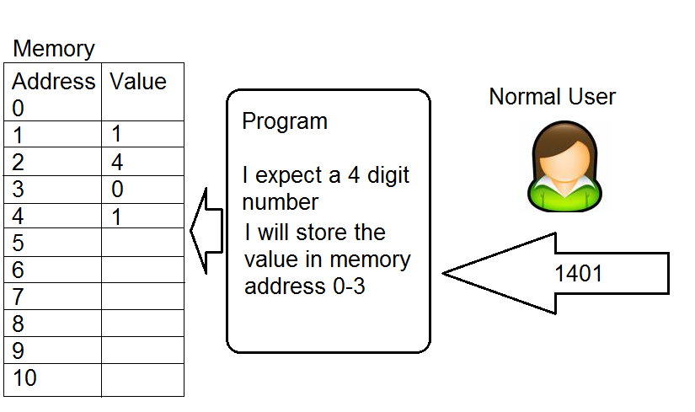
Buffer Overflow

Slide 203
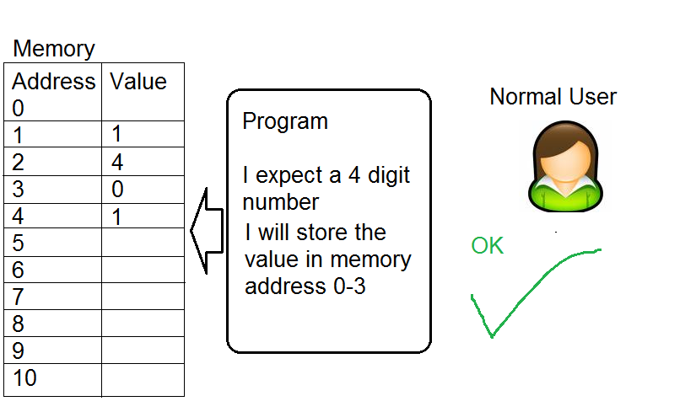
Buffer Overflow

Slide 204
Buffer Overflow

Slide 205
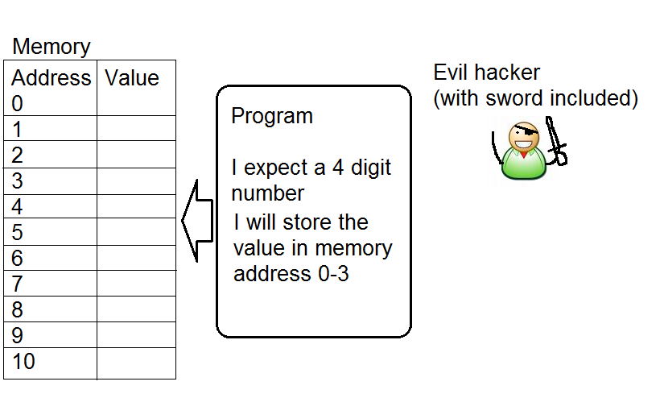
Buffer Overflow

Slide 206
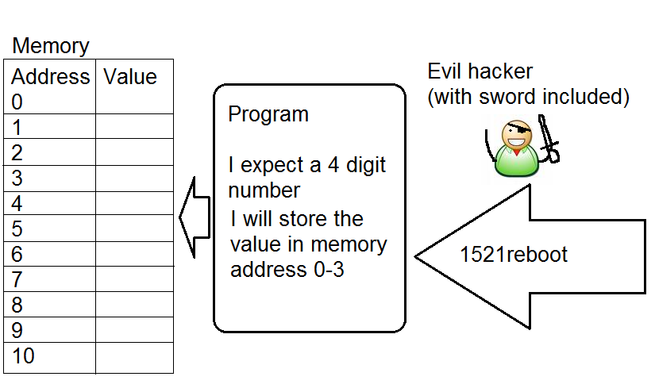
Buffer Overflow

Slide 207
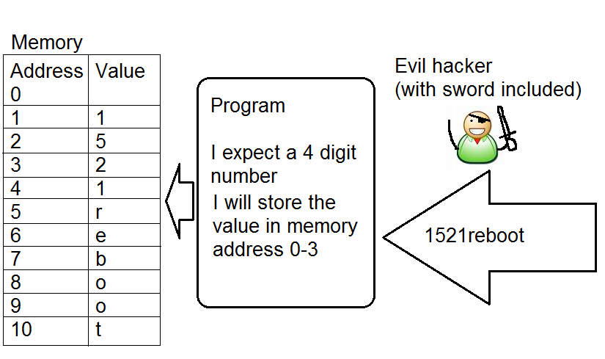
Buffer Overflow

Slide 208
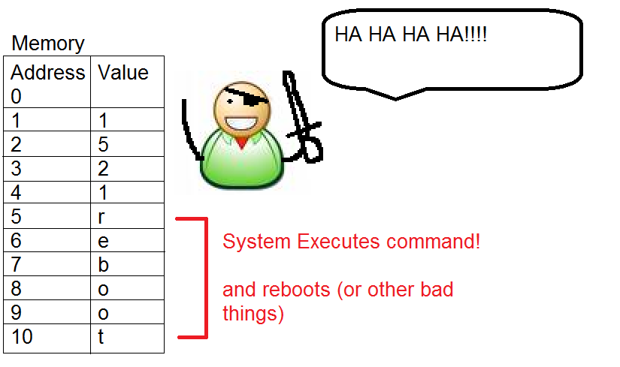
Buffer Overflow

Slide 209
Buffer Overflow
The previous example as shown was closer to command injection.
A real stack based buffer overflow would replace the reboot command with the machine code to make the system reboot, as well as over writing the return pointer on the stack with the address of the inserted machine code that would reboot the computer.

Slide 210
Buffer Overflows
Common buffer overflow types
Stack based
Heap based

Slide 211
Buffer Overflow
Best Defense against buffer Overflows
Educate software engineers with secure coding practices including input validation
Patching and making sure code is latest version (systems administrators)

Slide 212
Buffer Overflow
Buffer overflow defense unlikey to be seen on the exam.
Stack Canaries (compilers)
Non-executable stack and non-executable memory sections
NX bit
DEP
Address Space Layout Randomization (ASLR)

Slide 213
Maintenance Hooks
A backdoor that software developers put into the code so they can easily access a system for the purpose of troubleshooting.
Countermeasures
Code reviews by 3rd parties, if source code is available
Use an IDS system to detect backdoors/maintenance hook usage
Auditing (same as above)

Slide 214
Time of Check/Time of Use Attack
A situation where the outcome of a command or processes are dependant on when certain steps are done.
Example.
Imagine I have $50.00 in an online gambling account. I say “bet all that’s in my account” on a football game tonight. After I place the bet I insert an additional $500.00 to my account. If for some reason that deposit gets in before the bet goes though, I might end up betting $550.00 when I only meant to bet $50.00

Slide 215
Time of Check/Time of Use Attack
Countermeasures
Do not split up critical tasks into pieces (make transactions atomic
Lock out resource access to new operations while a current operation is running.
Basic database concept of transactions
Race conditions are a time of ToC/ToU attack.

Slide 216
Patch Management

Slide 217
Patch management
Systems must be constantly updated/patched. There should be a process to handle applying patches and system updates. This is called a “Patch management process” and the goal is to introduce patches in a controlled and tested fashion and to have a rollback plan. Patch management follows a 6 step methodology.

Slide 218
Final Thoughts

Slide 219
Final Thoughts

Slide 220
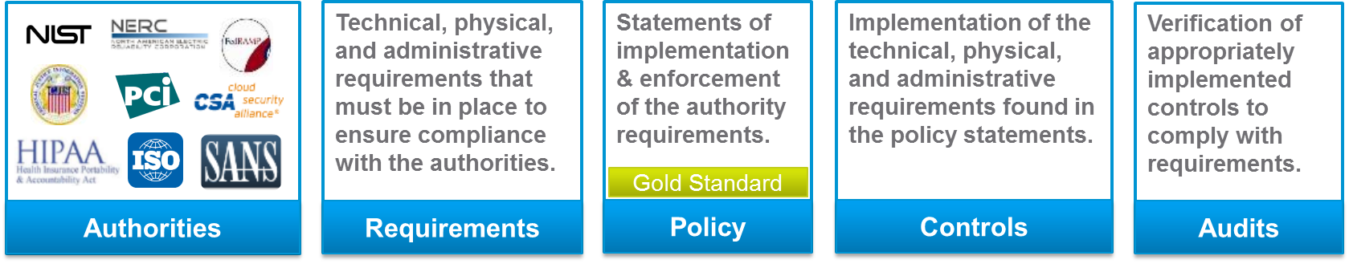
From Authorities to Audits
G
Maturity – maintain over time, preserve operations
Stakeholder-Driven
R
Business Requirements – prevent compromise, data loss, downtime
Business-Driven
C
Minimum Requirements – prevent fines
Data-Driven

Slide 221
Effectively Managed IT Controls
Technology can affect every part of the business.
At its best, technology is a competitive advantage.
At its worst, technology is your competitor’s advantage.
Product
Market Relationships
IT Controls:
Detective, protective and reactive measures in place to protect the confidentiality, integrity, and availability of business information and ensure appropriate management of the IT function to meet business objectives.
Inbound Logistics
Operations
Outbound Logistics
Marketing
and Sales
Service
Firm Infrastructure
HR Management
Margin
Procurement
Technology Development
Notes:
Compliance Control: A process, effected by management and other personnel, designed to provide reasonable assurance that transactions are executed in accordance with 1) laws governing the use of budget authority and other laws and regulations that could have a direct and material effect on the financial statements or required supplementary stewardship information and 2) any other laws, regulations, and government wide policies identified in OMB audit guidance. [GAO/PCIE Financial Audit Manual]
Source: http://www.unifiedcompliance.com/it_compliance/language_compliance/definitions/c.html

Slide 222
Chris Davis
UTD Email: cmd140430@utdallas.edu
Google Voice: 214-771-8122
Course Materials
https://elearning.utdallas.edu

Slide 223
Additional Materials

